Slide 1
College of Medicine
Standardized Curriculum Vitae
Fall 2016

Slide 2
The Problem
The condition of many of our faculty’s CV is hurting them.
Greensheets are burden and not designed for COM faculty.
Most Greensheets are not correctly filled without consequence.
The Provost doesn’t even look at them.

Slide 3
Hypothesis
A standardized format CV would/could;
With a personal statement, replace Greensheets
Decrease faculty workload
Redirect faculty efforts to better use
Present faculty accomplishments in a better light

Slide 4
Specific Aims
Develop a replacement for Greensheets
Develop a robust standardized CV

Slide 5
Progress to Date
Proposal developed
Broad discussion
GFA survey
23 responses (Fantastic!)
Format: Their own-19, AAMC- 2,No std format-2
4) Subcommittee of the COM FSC reviewed and recommended UCSF
5) Developed a Draft CV Format
6) TA “Drama-free Promotion” Mentoring ; N~12 (Beta test)
7) Approved by the COMAC(Dept. Chairs) in August
8) Widely disseminated to faculty/departments

Slide 6
Results
Uniformly praised
Few suggestions for change/improvements

Slide 7
Current “Plan”
Encourage a few brave (non tenure track) souls to replace Greensheets with CV etc
Next Spring all reappointments will require the new CV format
THE GREAT HOPE
Next fall promotions will be Greensheet-free

Slide 8
What do you/we most wish to gain from this session?
Purpose of a CV
Enhance promotion or tenure opportunity
Nut & bolts
Q & A

Slide 9
Curriculum Vitae
from the Latin:
“Curriculum” (course)
“Vitae” (of life)
Your CV is the only complete record of your achievements
Will be your first and last impression

Slide 10
CV Purpose
Job application
Grants
Awards
Periodic review
Visiting Professor
RPT process
Teaching Academy

Slide 11
The CV and Promotion - where the rubber hits the road -
In your letter would you please,
Note that you are evaluating the scholarship since the previous promotion action and not necessarily the number of calendar years. This is especially important in cases being reviewed for promotion to Associate Professor. Our campus has a tenure rollback policy that is granted on a case-by-case basis after review.
Discuss the candidate’s work in a critical fashion, commenting on the quality and impact of the candidate’s scholarship.
Comment on the volume of the candidate's scholarly activities relative to the standards in the field.
Remark on the quality of the publishing outlets and the source of funding when such is not obvious.
Estimate his/her standing in the field, and compare the candidate with other faculty of roughly the same cohort.
We are not asking for a summary of the c.v., what we seek is a substantive evaluation of Dr.__________ ‘s qualifications for promotion to the rank of __________ and of his/her reputation on the field. We understand that you may not be in a position to comment on all areas to be evaluated for promotion.
U Illinois-Chicago

Slide 12
Importance of your CV in Promotion/Tenure Application
Most external referees rely heavily on CV.
It’s the whole game
It will be the only document an external referee looks at before writing evaluation.
They are busy and don’t have time
External letters weigh heavily in internal reviews.
Start to finish it’s all about the CV
Update, organize, and polish your CV.
Best investment of time you can make

Slide 13
CV format
No single, correct format
Highlights strengths, accomplishments, and experience
strongest aspects and match stand out when skimmed
enough supporting detail to stand up to thorough scrutiny
Organized with CATEGORIES via headings/subheadings
Consistency in format, item order throughout
The appearance and organization of the CV is just as important as the content.
Neatness counts
Don’t get cute
Remember many (most) will just skim …
What impression will you create in less than 10 seconds?

Slide 14
CV style
Place most important information:
- first page
- left side of page
- beginning of sections
Use highlighting judiciously
Use action verbs to describe experience
Examine job posting; include relevant KEYWORDS
Use bulleted sentence fragments
- Avoid pronouns, articles, jargon
PROOF, PROOF, PROOF
Ask colleagues/faculty to PROOF

Slide 15
Common Mistakes
Missing academic title.
Listing proposed title, rather than current title; confuses external references, irks internal reviewers!
Failure to update title after accepting a new position or role.
Typos.
Sloppy, inconsistent formatting.

Slide 16
Common Mistakes
Failure to list all grants. Include pending and not funded. If you applied, but the grant did not get funded and you don’t list that outcome, it looks the same as not trying.
Poor organization
Misrepresenting non-peer-reviewed publications as though they are peer-reviewed

Slide 17
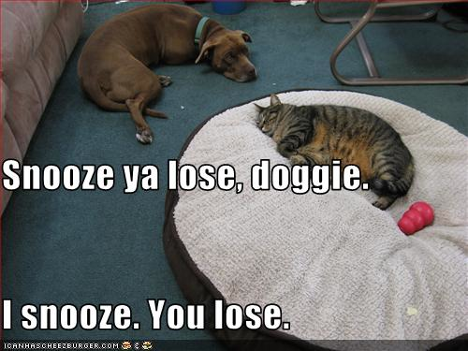
When to work on your C V
EVERY time something happens:
Stop
grab it
record it
file it.

Slide 18
Questions?
Schedule a one-on-one consultation and take your CV to a new level

Slide 19
Tips
Imagine your CV is one of 8 and external references must assess quickly.
What first impression does yours make?
Is it confusing, daunting? If so, revise, reorganize.
Aim for clear, organized, readable
NOTE: Internal reviewers will see 4 – 80 applicants
Use white space, bold face type, tabs, categorization to improve readability, organization

