Slide 1

ED-Initiated Buprenorphine for
Opioid Use Disorder
Gail D’Onofrio MD
Professor and Chair
Department of Emergency Medicine
Yale University School of Medicine

Slide 2





Disclosure Statement
Current grant funding:

Slide 3
We Know…
The Extent of the Problem

Slide 4
40.3 million Americans >12 years of age have a
substance use disorder
2.7 million have an opioid use disorder
9.3 million report non-medical use of pain relievers
in the past year
Results from 2020 NSDUH, October 2021

Slide 5
Evolution of Drivers of Overdose Deaths, All Ages
Analgesics Heroin Fentanyl Stimulants
Driven by synthetic opioids and the pandemic
2020 Data
103,306 OD Death
28.5%
Source: The Multiple Cause of Death data are produced by the Division of Vital Statistics, National Center for Health Statistics (NCHS),
Centers for Disease Control and Prevention (CDC), United States Department of Health and Human Services (US DHHS). Slide Created by Nora Volkow

Slide 6

Economic Burden
From: The Cost of Opioid Use Disorder and the Value of Aversion
Murphy, SM. Drug and alcohol dependence. 217 (2020): 108382. doi: 10.1016/j.drugalcdep.2020.108382
Cost-effective OUD treatment is critical for personal, public, and economic health
Annual OUD-related costs to U.S. society in 2018 were $787 billion¹
  Excess healthcare expenditures: $89 billion
  Lost workplace productivity: $65 billion
  Justice-legal involvement: $30 billion
  Premature mortality: $603 billion
The mean present value of averting an OUD, across all ages = $2.2 million

Slide 7
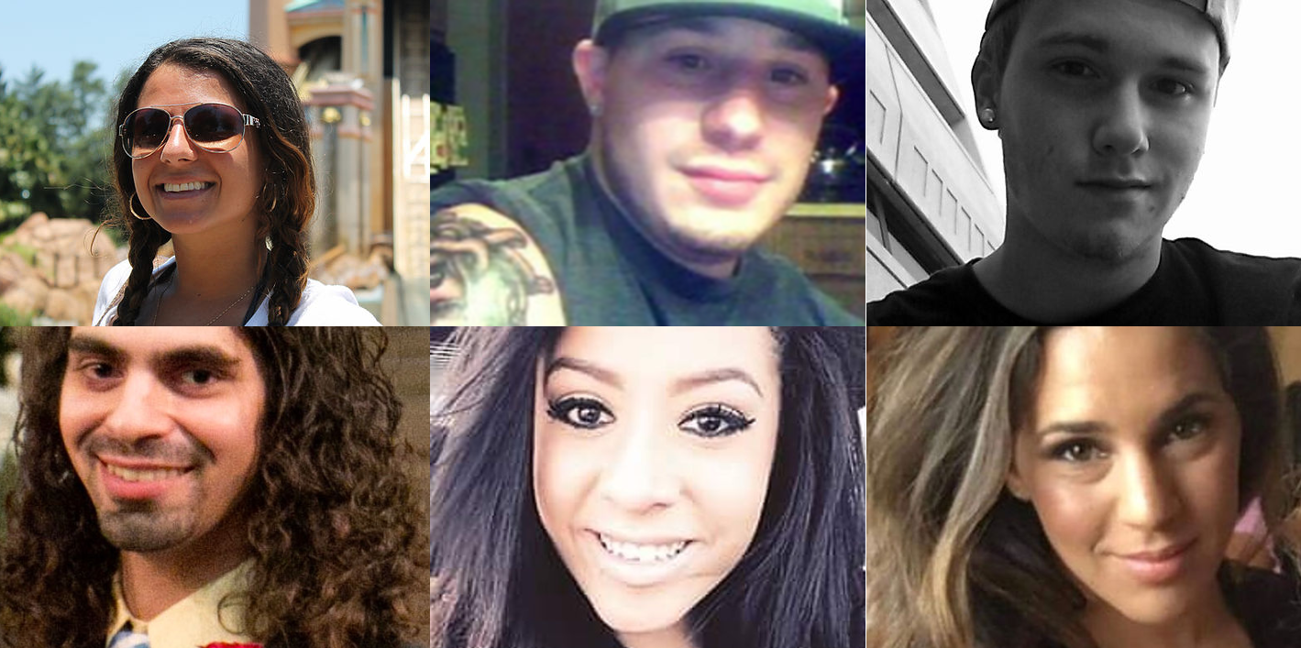

Recent CDC data for the 12-month period ending in April 2021 100,306 people in a single year
275 people lost in a single day
https://www.stop-overdose.org/

Slide 8
Treatment Works
We Know…

Slide 9
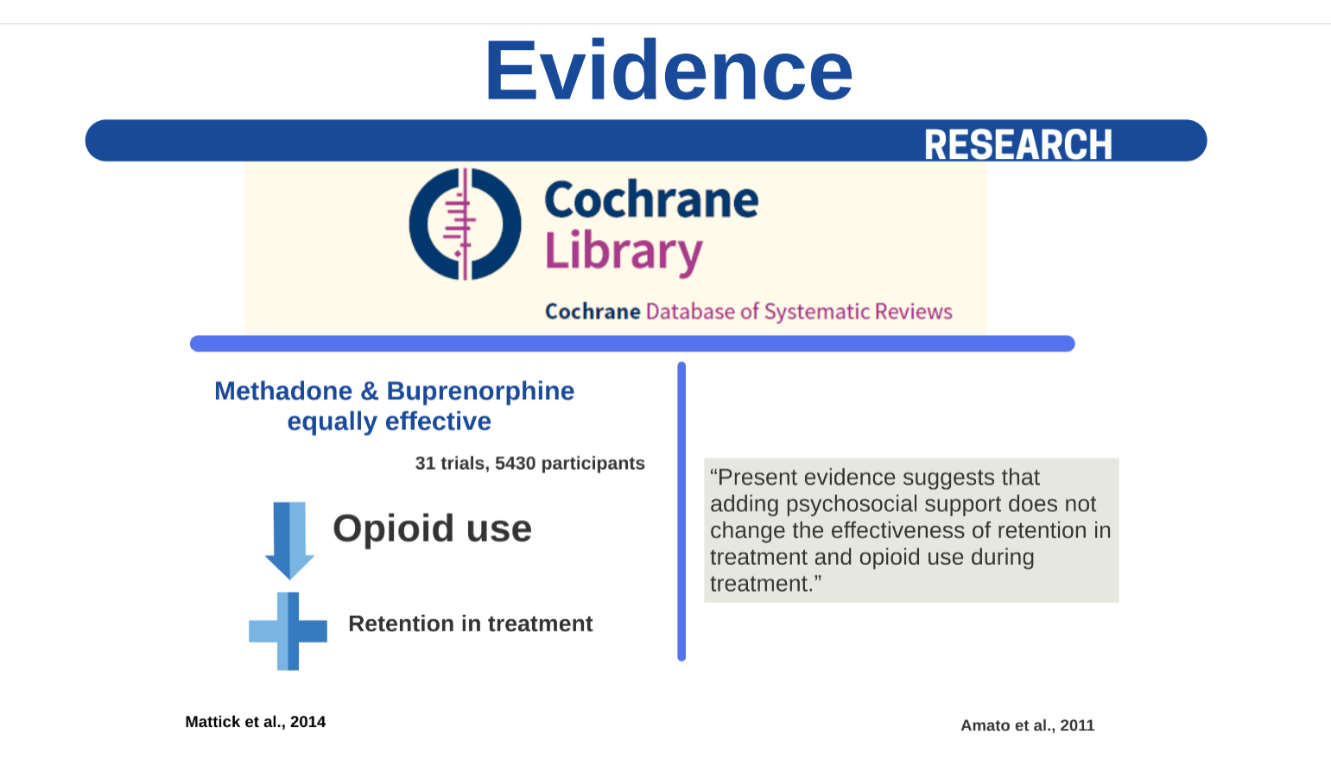

Slide 10
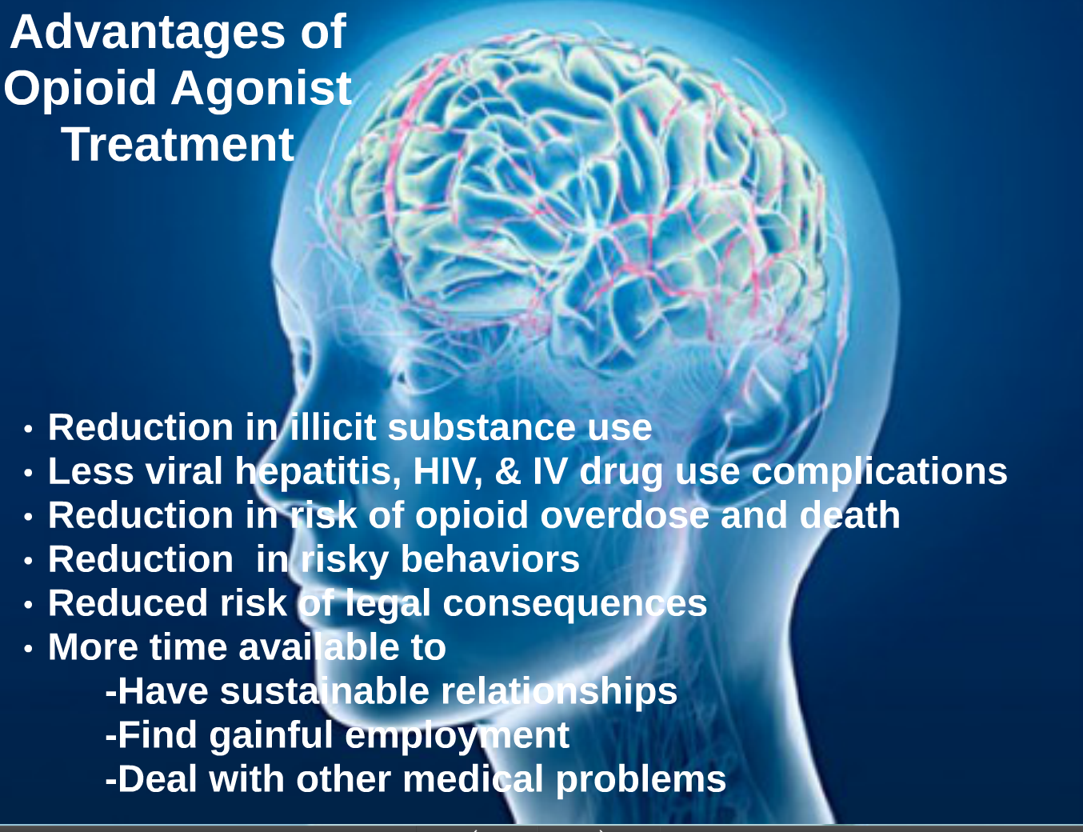

Slide 11
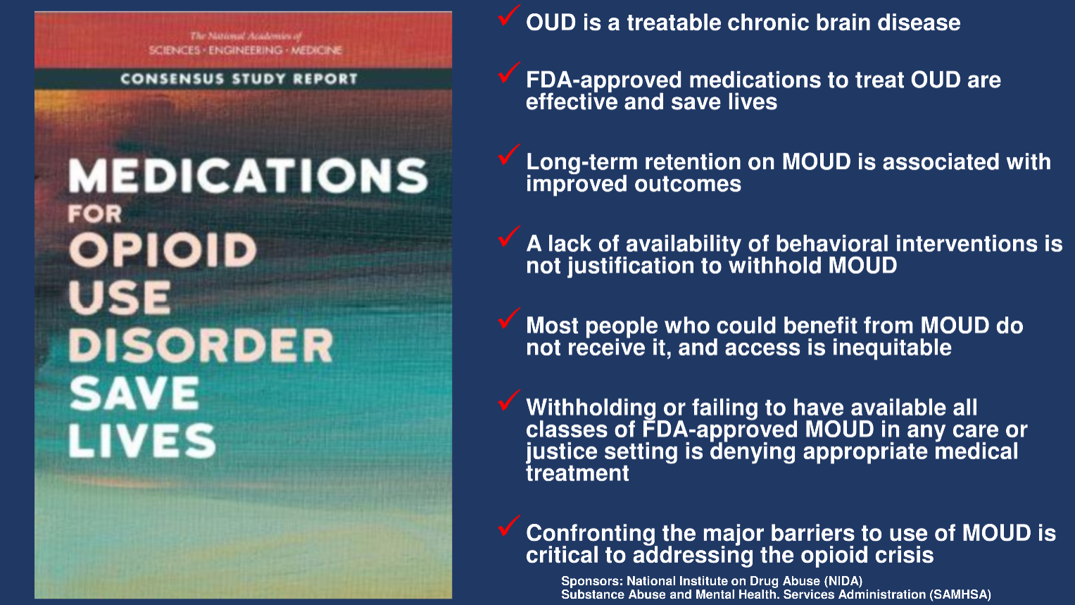
2019

Slide 12
We Know…
The ED Offers the 24/7/365 Option to Combat the Opioid Crisis

Slide 13
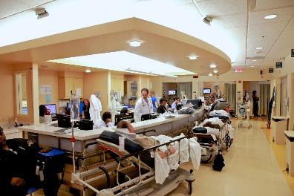
Why focus on the ED?
Because that’s where the patients are!
Approximately one of every 80 visits to the ED are opioid-related (costing 5 billion per year)
Langabeer, Drug & Alcohol Dependence, Jan 2021

Slide 14


Overdose
Seeking Treatment
Identified/Screening

Slide 15
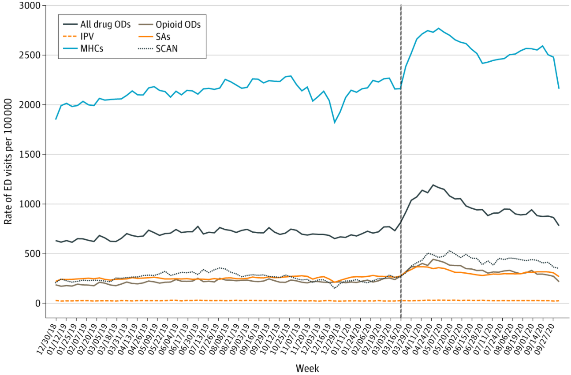
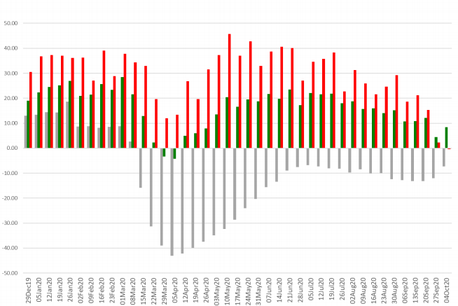
COVID 19 Collides with the Opioid Epidemic
Rate of ED Visits per 100,000
Mental Health Conditions
Percent change
Total ED Visits
Opioid ODs
All ODs
All Drug ODs
Opioid ODs
Weeks
Weeks
Count of ED Visits in the US
December 30, 2018, to October 10, 2020
Weekly % Δ in Total ED visits, all drug OD, and opioid OD in 2020 compared to 2019
Holland, JAMA Psych, Feb 2021

Slide 16
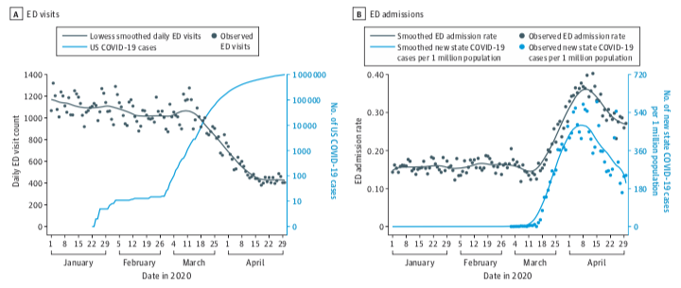
Leveraging existing infrastructure for clinical data collection/population health
Trends in ED visits, hospital admissions, and non-fatal opioid overdoses in the first months of the COVID-19 pandemic across 5 health systems in 5 states
Figure:
Jeffery et al. JAMA Intern Med 2020;180(10): 1328-33.
Soares et al. Ann Emerg Med 2021 Mar 19; online ahead of print.

Slide 17
We Know…
The Consequences of Inaction

Slide 18
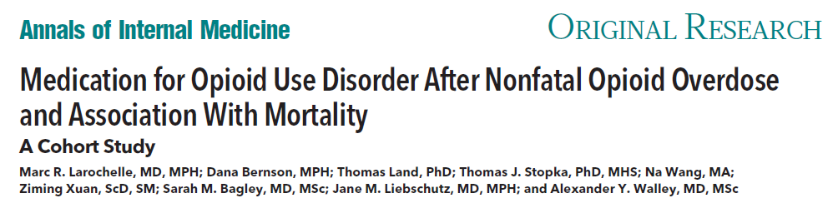
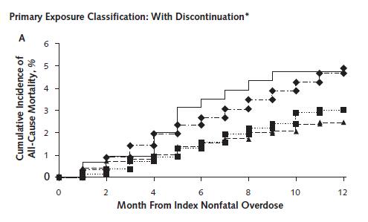
N=17,568 2012-2014
12 months post non-fatal OD
  30% received MOUD
  4.7% all-cause mortality
  2.2% opioid-related
  BUP and MMT decreased in mortality
No MOUD
Naltrexone
Bup
MMT
Larochelle, Annals of Int Med 2018

Slide 19
We Know…
The Evidence

Slide 20
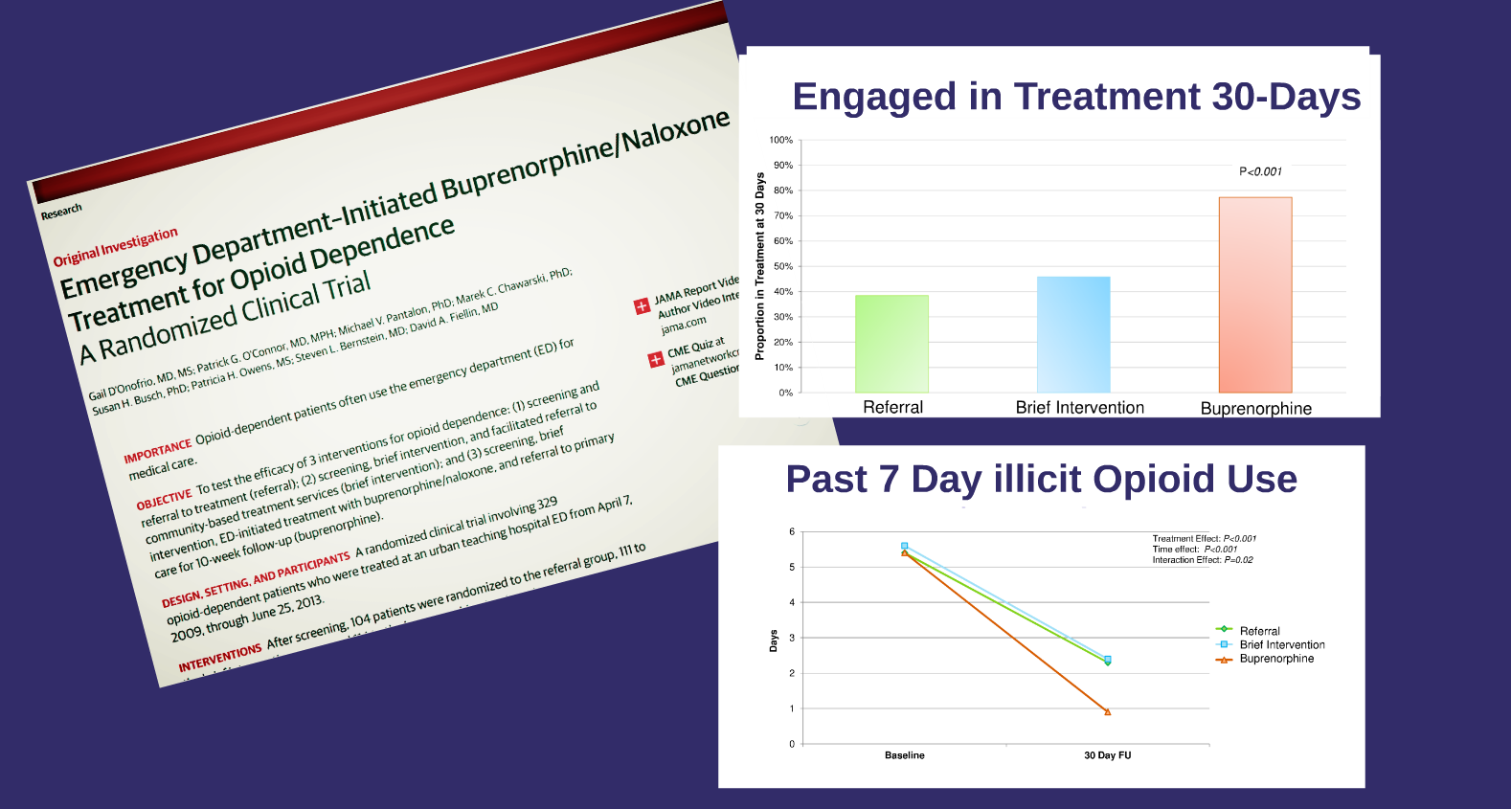
A Randomized Trial of ED-Initiated Interventions for Opioid Dependence
NIDA 5R01DA025991
D'Onofrio JAMA 2015

Slide 21
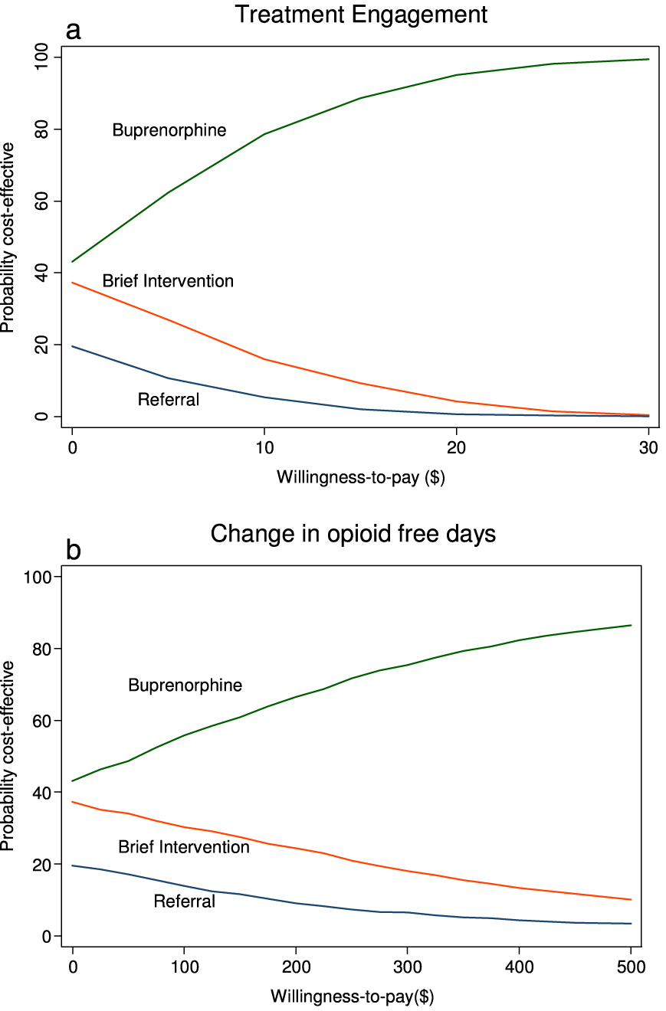
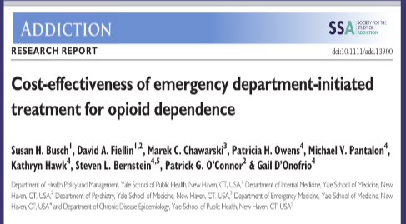
Cost‐effectiveness of ED‐initiated
Treatment for Opioid Dependence
Cost-effective acceptability curve: base case analysis
Willingness-to-pay for a 1 percentage point increase in the
probability a patient is engaged in treatment 30-days post-
enrollment.
Willingness-to-pay for 1 additional opioid-free day in the
past 7-days
Busch Addiction 2017
Notes:
Cost‐effective acceptability curve: base case analysis. (a) Willingness‐to‐pay indicates willingness‐to‐pay for a one percentage point increase in the probability a patient is engaged in treatment 30‐days post‐enrollment. (b) Willingness‐to‐pay indicates willingness‐to‐pay for one additional opioid‐free day in the past 7 days. [Colour figure can be viewed at wileyonlinelibrary.com]
IF THIS IMAGE HAS BEEN PROVIDED BY OR IS OWNED BY A THIRD PARTY, AS INDICATED IN THE CAPTION LINE, THEN FURTHER PERMISSION MAY BE NEEDED BEFORE ANY FURTHER USE. PLEASE CONTACT WILEY'S PERMISSIONS DEPARTMENT ON PERMISSIONS@WILEY.COM OR USE THE RIGHTSLINK SERVICE BY CLICKING ON THE 'REQUEST PERMISSIONS' LINK ACCOMPANYING THIS ARTICLE. WILEY OR AUTHOR OWNED IMAGES MAY BE USED FOR NON-COMMERCIAL PURPOSES, SUBJECT TO PROPER CITATION OF THE ARTICLE, AUTHOR, AND PUBLISHER.

Slide 22
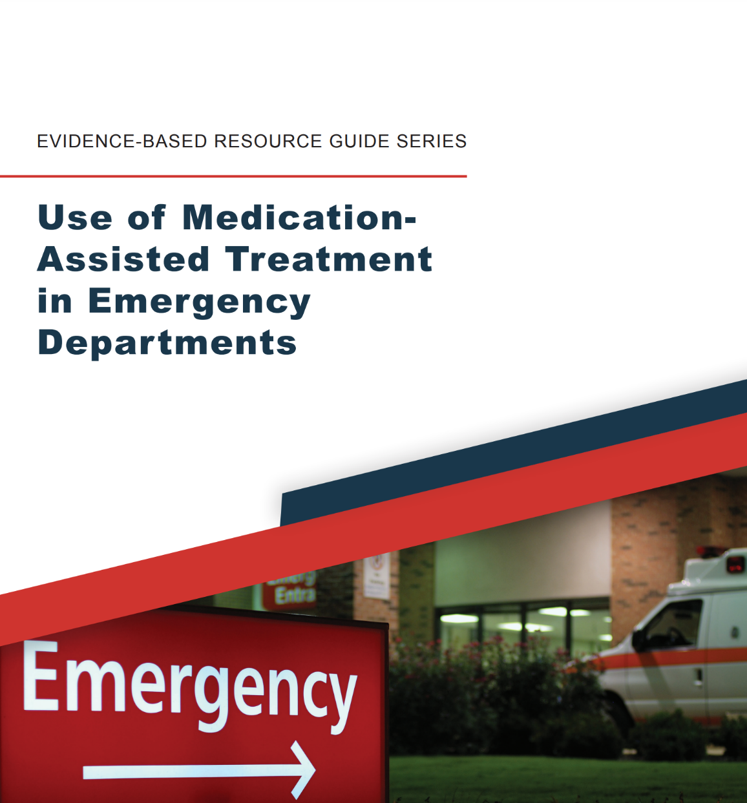
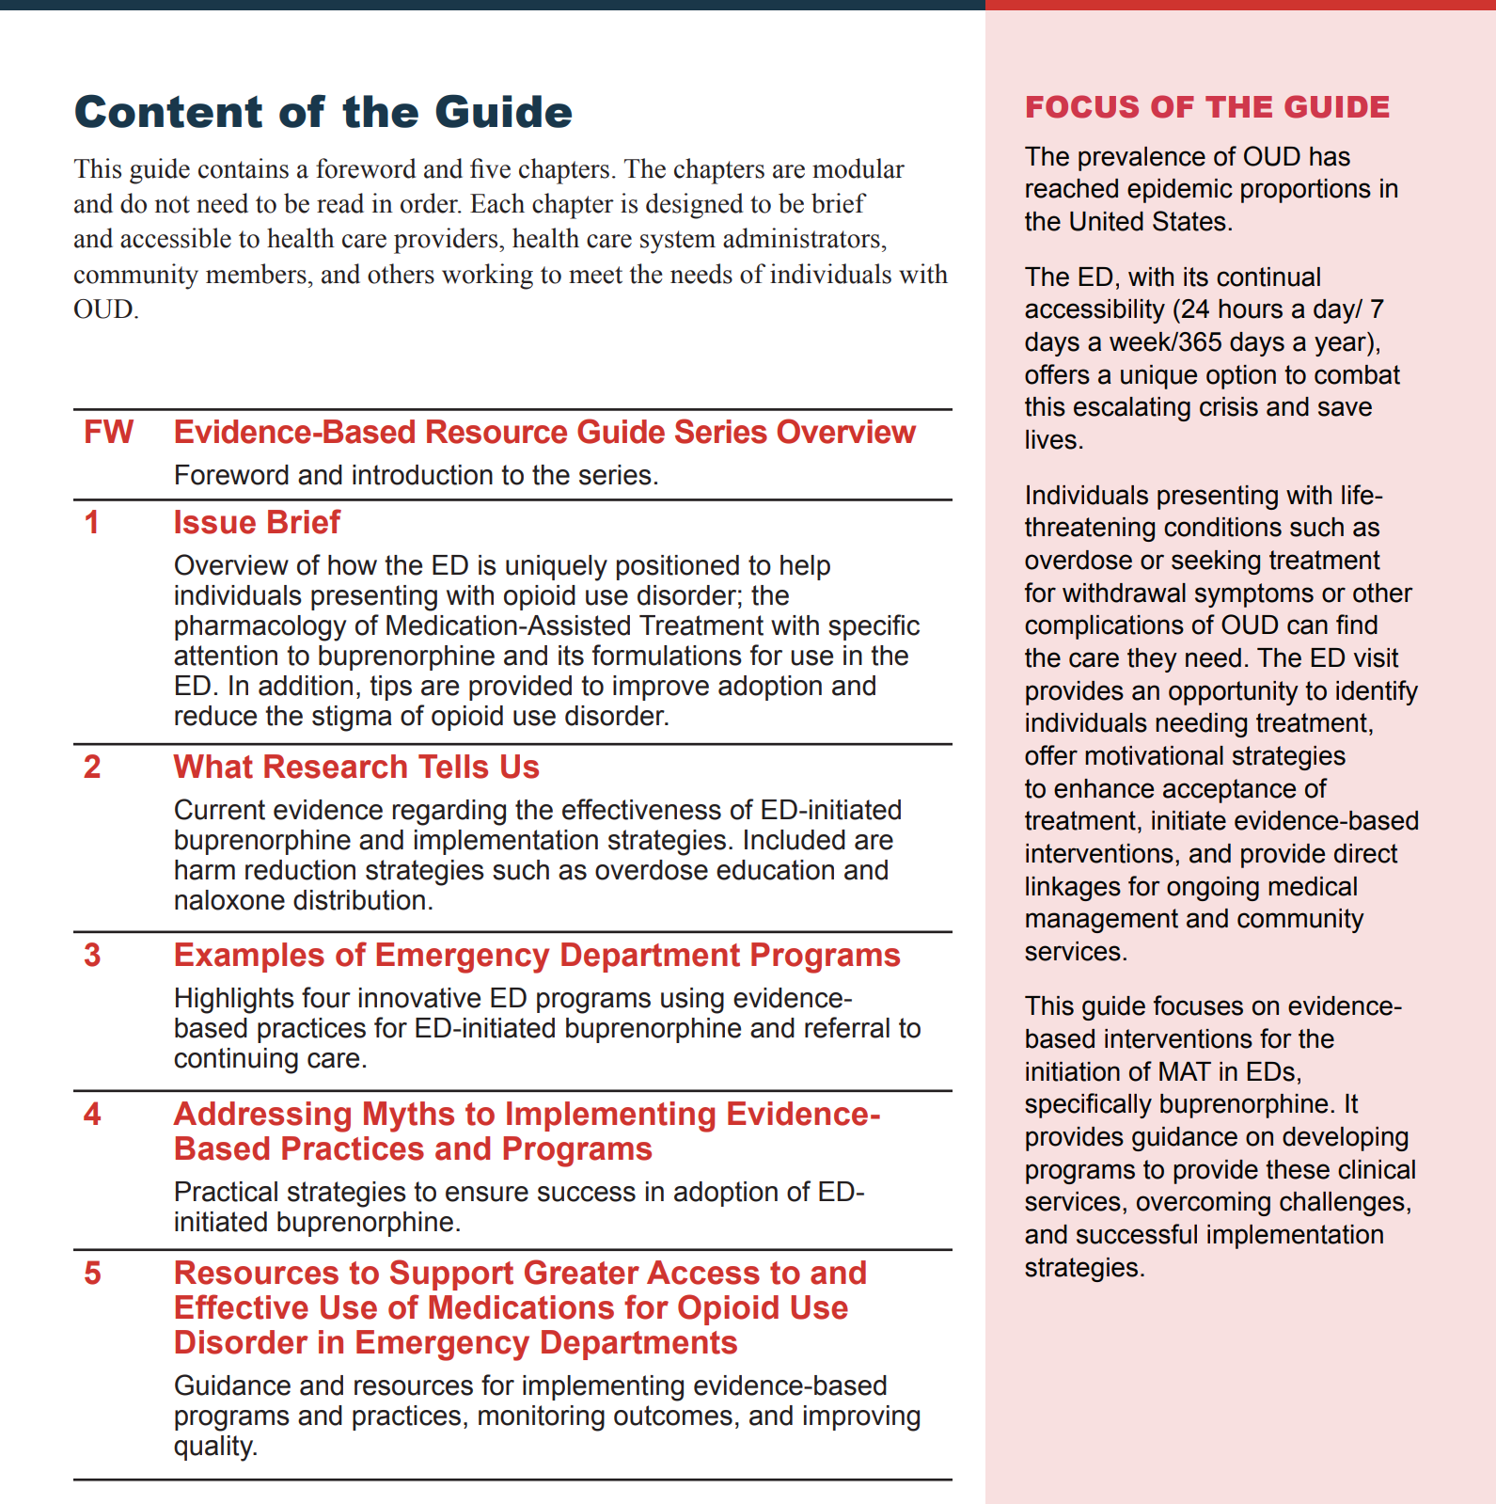


Slide 23

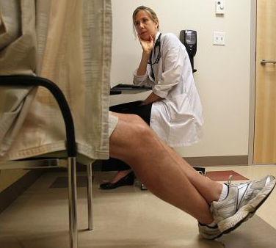
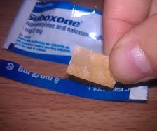
Clinicians can…
Identify patients with OUD
Provide treatment
  Initiate buprenorphine
Provide Harm Reduction strategies
  Overdose education and naloxone distribution
Directly link patient to ongoing addiction care & preventive services

Slide 24
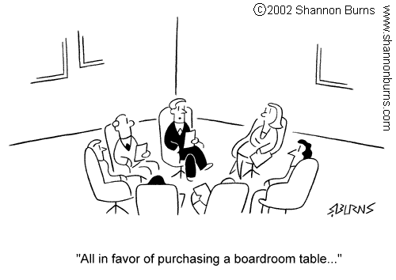
The latest research shows that we really should do something with all this research

Slide 25
We Learned…

Slide 26



CTN-0069 Project ED Health
Opioid Use Disorder in the Emergency Department
Gail D’Onofrio MD, MS
David Fiellin MD
Yale University
School of Medicine

Slide 27
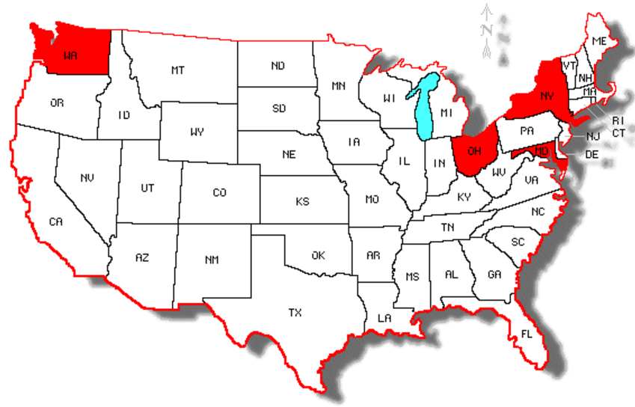
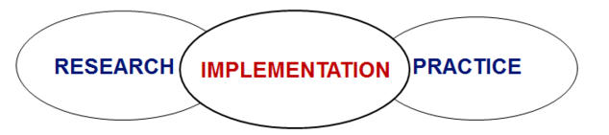
CTN 0069: Opioid Use Disorder in the ED
Design: Hybrid Type 3 Effectiveness-Implementation Study
Using a multisite stepped wedge design allowing for:
(4) Academic, Urban EDs
Dual testing of effects & implementation
interventions
Testing of an implementation strategy while
observing and gathering information on the
intervention’s impact on clinical outcomes
Emphasizing implementation over effectiveness
Mt Sinai
Harborview
U of
Cincinnati
Johns Hopkins
D'Onofrio, Implementation Science, 2019
Notes:
0069 was born

Slide 28
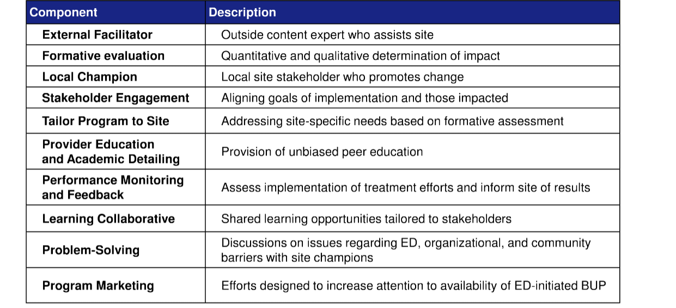
Components of Implementation Facilitation
Curran GM, et al. Med Care. 2012;50(3):217–26.

Slide 29





NIDA CTN-0079 ED-CONNECT
Implementation of ED-BUP programs in rural and urban settings with high need and limited resources
McCormack
Hawk
6-month evaluation
  112 of 134 (83.6%) unique ED-BUP candidates received BUP
  Approx. 50 unique ED providers
Among the 40 BUP-recipients enrolled:
Successfully linked to OUD treatment
    50% engaged at 30 days; 70% had ≧ 1 visit
Decreased Opioid Use
    -2.9 days/week (p<0.001); 51.4% negative toxicology
  Fewer opioid overdoses
  Odds of overdose was 4x higher at baseline (95% CI: 1.3-12.8; p=0.019)
Catholic Medical Center Manchester NH
Valley Regional Hospital, Claremont NH
McCormack, Addict Sci Clin Pract 2021
Bellevue Hospital, NY
Notes:
Primary Of the n=134 unique adult ED patients identified to be eligible and willing to receive ED-initiated BUP according to criteria delineated in site-specific clinical protocols, 112 (83.6%) received ED-initiated BUP
Secondary: Of the 40 patient-participants who received ED-initiated BUP, the proportion and corresponding 95% confidence interval who were engaged in treatment 30 days after the initial ED visit were estimated via a Bayesian method to be 49.0% (35.6% - 62.5%).
Main Secondary Outcome ­– Engagement in Treatment at Day 30
Of the 40 patient-participants who received ED-initiated BUP, the proportion and corresponding 95% confidence interval who were engaged in treatment 30 days after the initial ED visit were estimated via a Bayesian method to be 49.0% (35.6% - 62.5%). Among the BUP-receiving patient-participants, 26 of 38 study completers (68.4%) reported attending a visit for OUD treatment after discharge.
Additional Secondary Outcomes Non-medical opioid use decreased:
The mean number of self-reported days of non-medical opioid use in the 7 days prior (via Timeline Follow-back [TLFB]) was 4.0 at baseline and 1.2 at Day 30; the mean difference of -2.9 (95% CI: -3.89, -1.95) between Day 30 and baseline was statistically significant (p<0.001).
18/35 (51.4%) had negative urine toxicology results for opioids at the Day 30 research visit (Table 5). 17/35 (48.6%) had positive toxicology for opioids, including 14/35 (40.0%) that were positive for fentanyl.
Overdoses decreased: There was a significant change in the likelihood of overdose involving opioids, as measured by self-report, in the 30 days prior to the baseline visit compared to the 30-days follow up visit (p=0.019). The Odds Ratio of 4.03 (95% CI: 1.27-12.75) suggests that the odds of 1+ days of overdose involving opioids where the patient-participant lost consciousness, needed medical care, or used more than patient-participant wanted was 4.03 times higher at baseline compared to Day 30
Buprenorphine use was confirmed by urine toxicology in 28/35 (80.0%) at day 30.
Outpatient visits increased: OR = 0.12 (95% CI: 0.04-0.37) suggests that the odds of 1+ visits in the past 30 days was 0.12 times lower at baseline compared to Day 30.
Treatment was highly acceptable: At Day 30, most patient-participants that received ED-initiated buprenorphine (67.5%) were satisfied or very satisfied with how buprenorphine works. The previously reported engagement in treatment outcomes are also indicators of acceptability. The average score at Day 30 for “On a scale of 1-10, how likely are you to recommend to others that they consider this treatment?” was 7.9 (SD = 2.57).
Quality of Life Improved: The mean EQ-5D-3L Health State Index Score was 0.68 at baseline and 0.76 at Day 30; the mean difference of 0.08 (95% CI: 0.0005, 0.16) between Day 30 and baseline was marginally statistically significant (p-value=0.049).

Slide 30
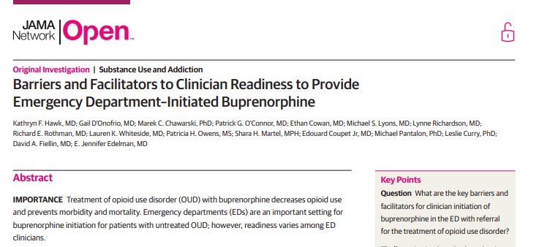
Clinician Barriers to Treat
Hawk, JAMA Open, 2020
Barriers to implementation:
Requirement for a X-waiver
Lack of experience in treating OUD with buprenorphine
Ability to link to treatment
Competing priorities for ED time and resources,
Misunderstanding and stigma toward patients with OUD
Solutions:
Training
Protocols integrated within the EHR
Targeted feedback to ED staff on patient outcomes
ACEP Consensus Recommendations
Hawk, Kathryn, et al. Consensus Recommendations on the Treatment of Opioid Use Disorder in the Emergency Department. Annals of Emergency Medicine (2021).

Slide 31
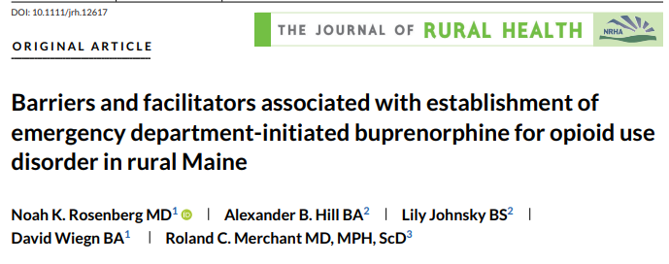
2021
  4 Themes
  of barriers & facilitators
Compelled to Act - Facilitator
Hospital Leadership and Peer Mentorship - Facilitator/Barrier
Stigma and Developing Community Outreach – Barriers
Follow-up visits - Barrier
Compelled to Act
Future Research: Focus on
“I was on a shift in the evening and received a patient from rescue squad who had overdosed and was in cardiac arrest . . . . He went to the ICU and then ended up dying the next day. It turns out that his wife died at the scene in the same [overdose] episode, and they had three children. I was just devastated. I could no longer just say, ‘Oh, it’s someone else’s problem.’ That case put it as my problem.”
Peer Mentorship
Administrative support
Community Outreach
Staff Education

Slide 32
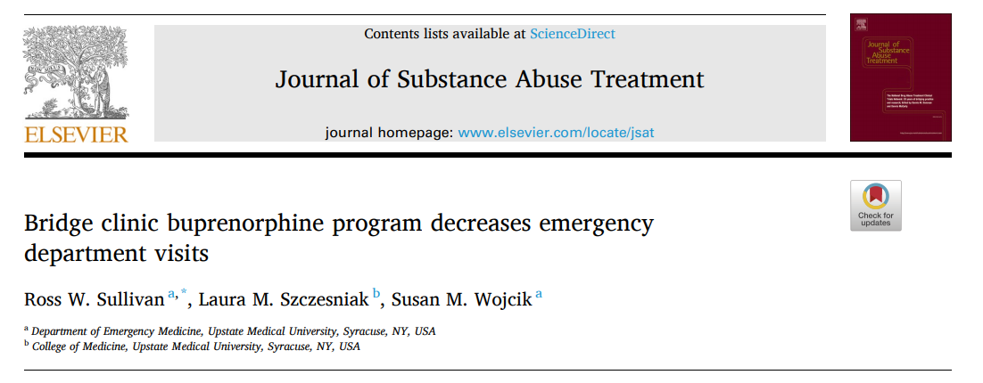
269 patients:
654 ED visits in 6-months prior to referral
381 ED visits in 6-months after referral (⬇ of 42%)
56% buprenorphine treatment adherence at 2- years
April 2021

Slide 33
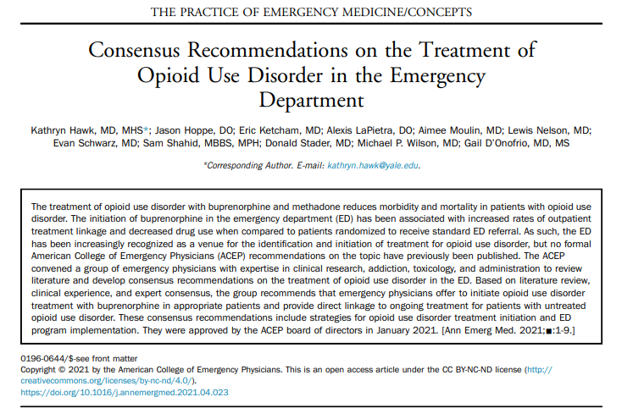
Extra Motivation

Slide 34
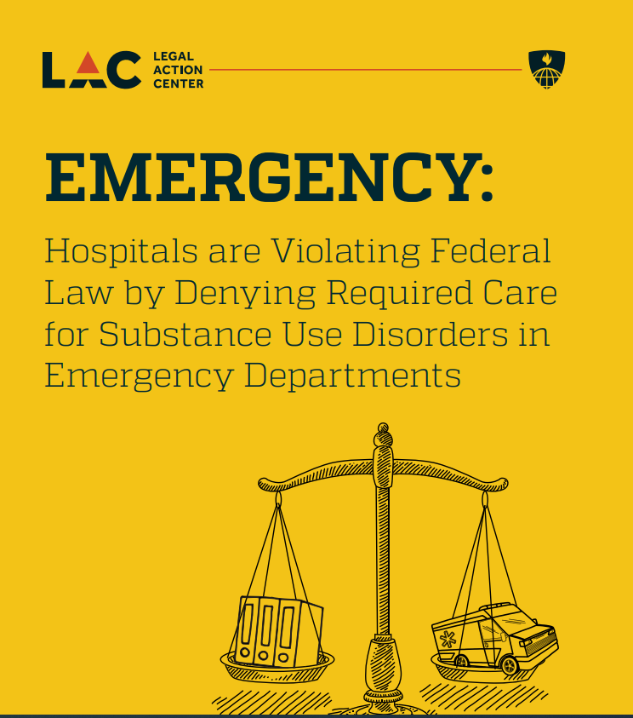
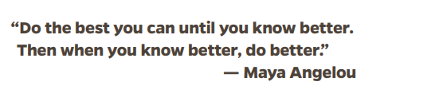
https://www.lac.org/assets/files/LAC-Report-Final-7.19.21.pdf
Key Legal Findings
Hospitals could be liable for violations of the Emergency Medical Treatment and Labor Act (EMTALA), the Americans with Disabilities Act (ADA) and Rehabilitation Act of 1973 (Rehabilitation Act) and Title VI of the Civil Rights Act of 1964 (Title VI), when they fail to adopt evidence-based practices, resulting in patient harm. “

Slide 35
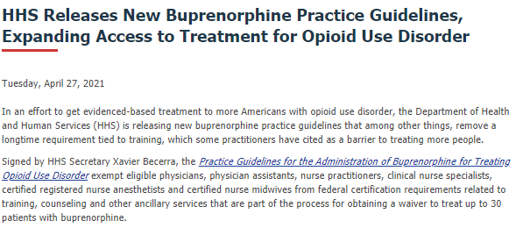

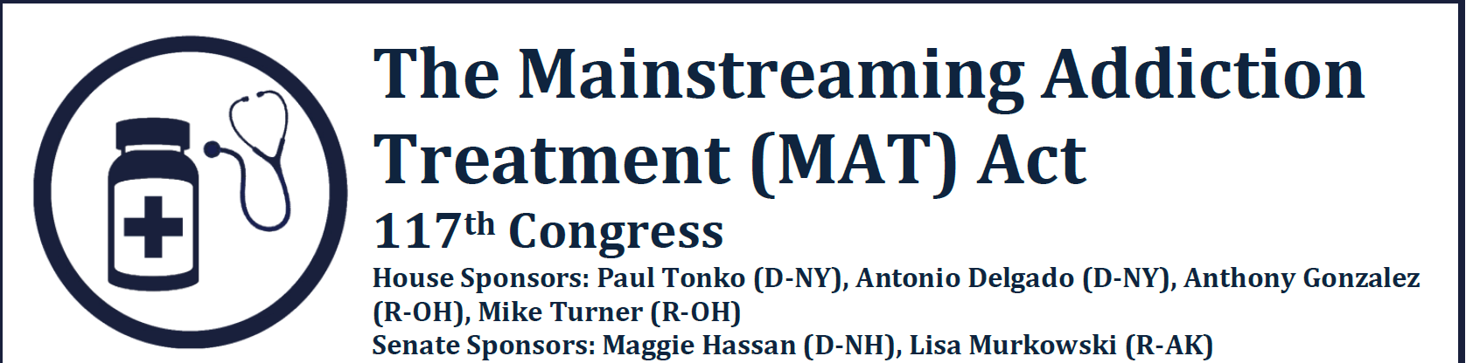

Title 21, Code of Federal Regulations, Part 1306.07(b)
72-hour rule
Anyone Can Treat Opioid Withdrawal with Buprenorphine
Title 21, Code of Federal Regulations, Part 1306.07(b)
Allows to administer (but not prescribe) narcotic drugs for the purpose of relieving acute withdrawal symptoms while arranging for the patient's referral for treatment
Not more than 1-day's medication may be administered or given to a patient at one time
Patient must return to ED each day for no more than 72 hours
This 72-hour period cannot be renewed or extended.
the x-waiver
D'Onofrio, Ann Emerg Med, In Press 2021

Slide 36
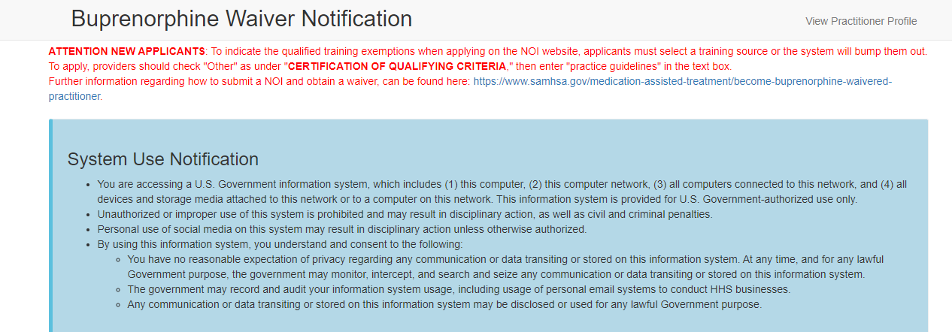
https://buprenorphine.samhsa.gov/forms/select-practitioner-type.php
Link to start the process:
Go to the following link: SAMHSA DATA Waiver
Fill in next page with DEA number and state license number.
Choose to apply for the 30-patient level. Under the notice of intent, you are only
  able to apply for the 30-patient level.
Under section 8, select "other" for the criteria for qualification. The form did ask us to fill out the date, city, and state where the certifying criteria took place. Fill out today's date and under "city" put "Practice Guidelines". Leave the state where you are licensed. This may change in the future and another box may pop up per SAMSHA. The key is to put "practice guidelines" as the criteria for qualification.
Fill out the other areas with the appropriate information and with your preferences.

Slide 37

Patient Themes (CTN 0069 & 0079)
Need for low-barrier access to treatment in the ED, particularly after overdose
Sense that ED staff did not understand addiction or perceive it as a medical disease
Perception that pain and medical issues were minimized or not taken seriously because of history of addiction
History of feeling stigmatized while receiving ED care, with recent variability noted across EDs
Rare positive experiences with clinicians
Stigma

Slide 38
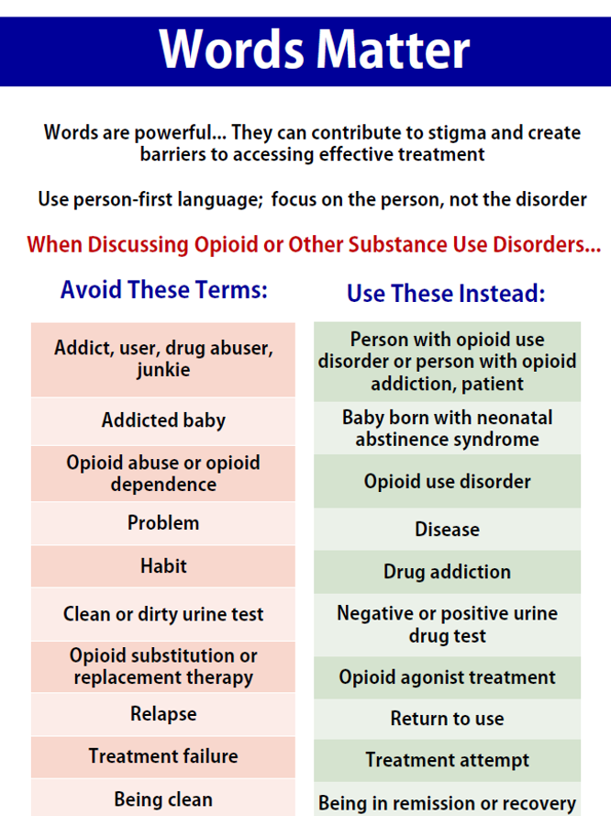
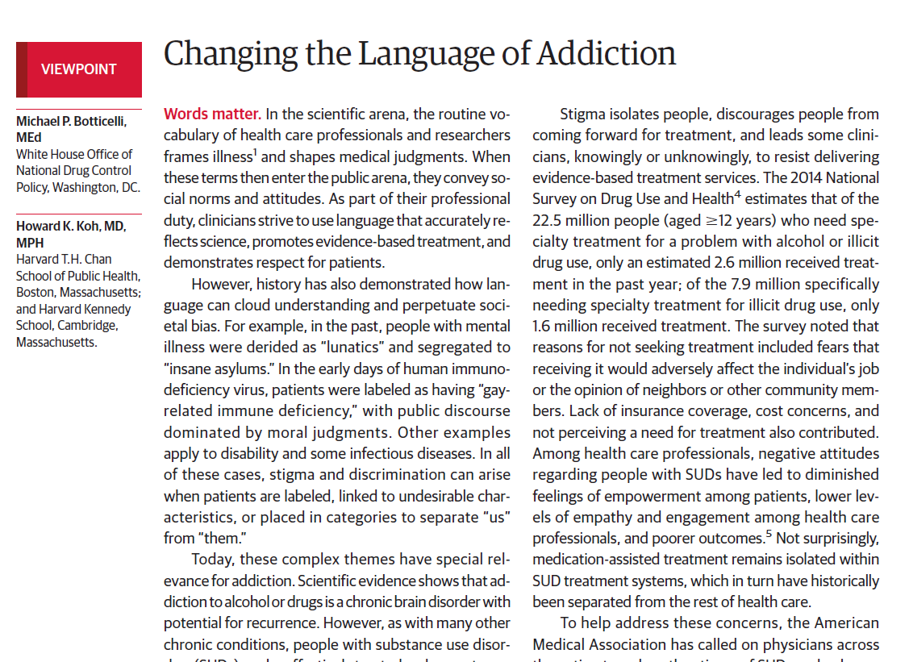
Words Matter

Slide 39
Patient Barriers
Inability to obtain life-saving medications at the ED touchpoint
  Provider does not have an X-waiver to prescribe
  Patient not in sufficient withdrawal to obtain ED dosing, and unobserved induction not possible without an X-waivered provider
Difficulty filling prescription
  Lack of proper identification and/or transportation
  Required insurance preapproval
Vulnerable populations with unstable housing and under/non-insured

Slide 40


Translating Research into Practice
Initiating
Treatment
Direct Linkage

Slide 41

How do I start buprenorphine in the ED?

Slide 42
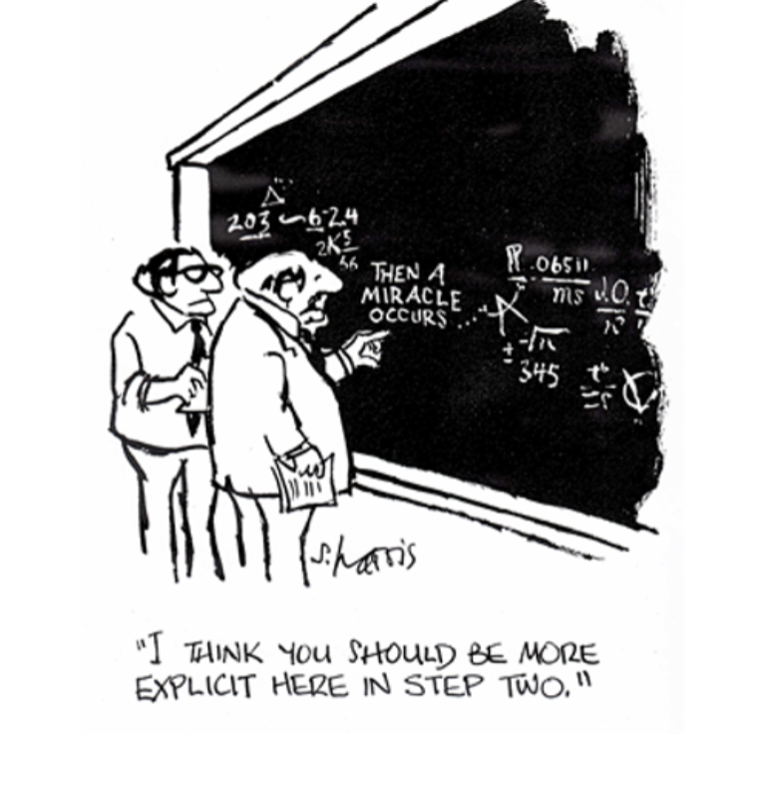

Resources

Slide 43
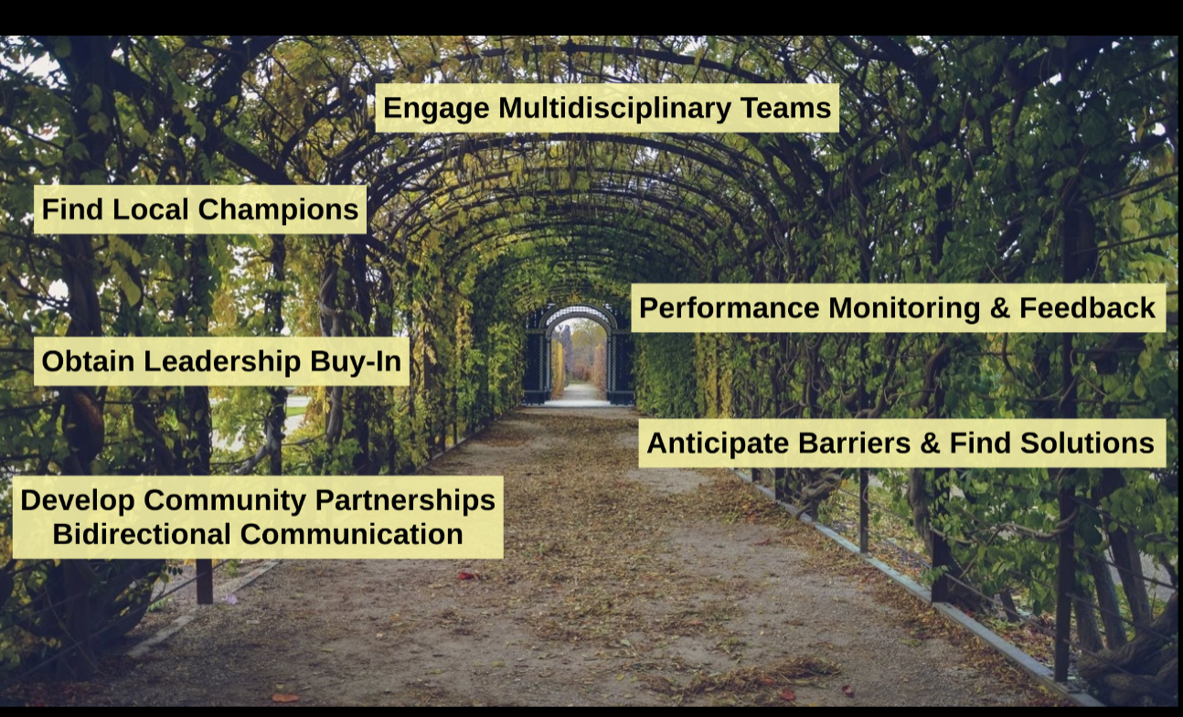
Build IT Infrastructure
Develop Protocols, Tools & Resources

Slide 44





Buprenorphine Integration Pathway
① Identify
② Assess
③Treat
ED Presentation
Identification of OUD based on DSM-5
OUD
④ Discharge (OEND)
& Refer to Treatment
Seeking Treatment
Screen Positive
Complication of Drug Use
  Withdrawal
  Overdose
  Infection
Identified during H&P
BNI
Buprenorphine algorithm
Clinical Opioid
withdrawal Scale
(COWS)
Withdrawal
Pregnancy
Urine/blood
Testing
BNI Brief Negotiation Interview
OEND Overdose Education & Naloxone Distribution

Slide 45
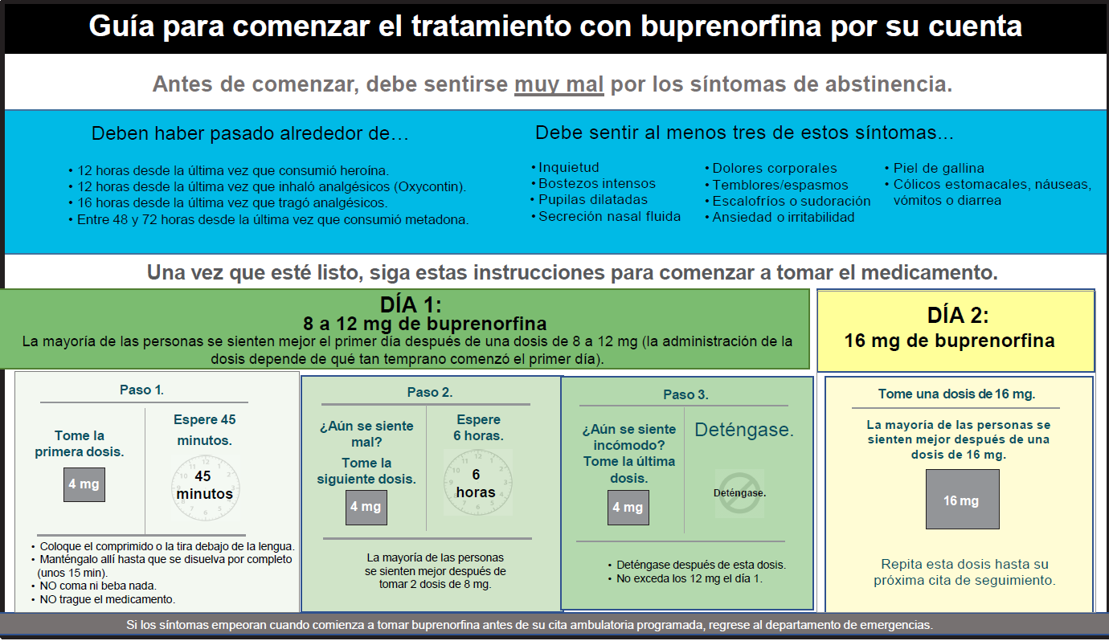
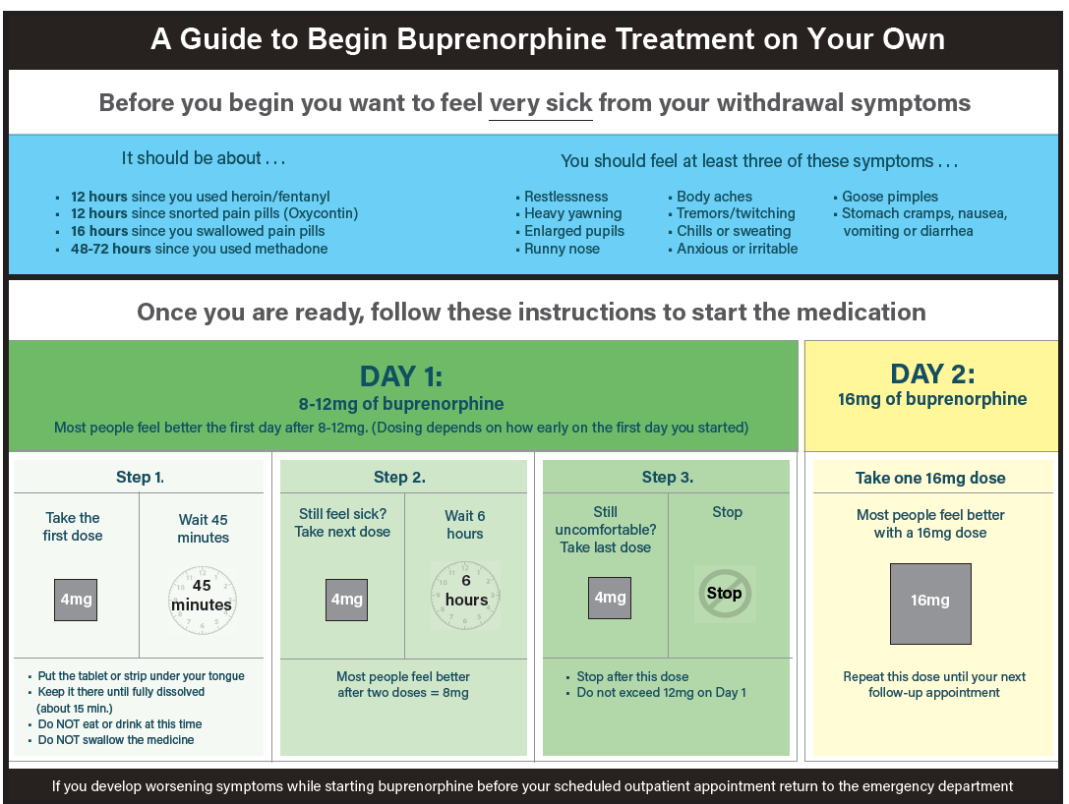

Slide 46
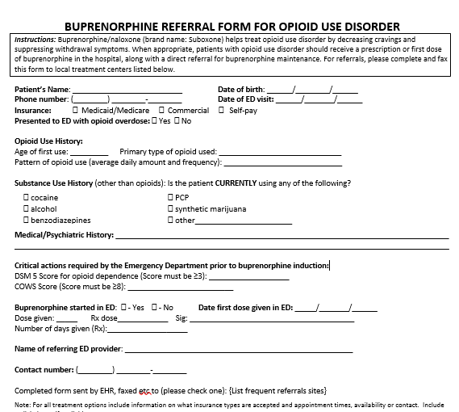
Buprenorphine referral form

Slide 47
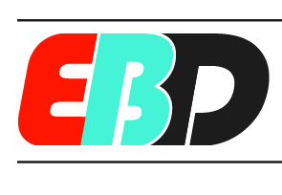
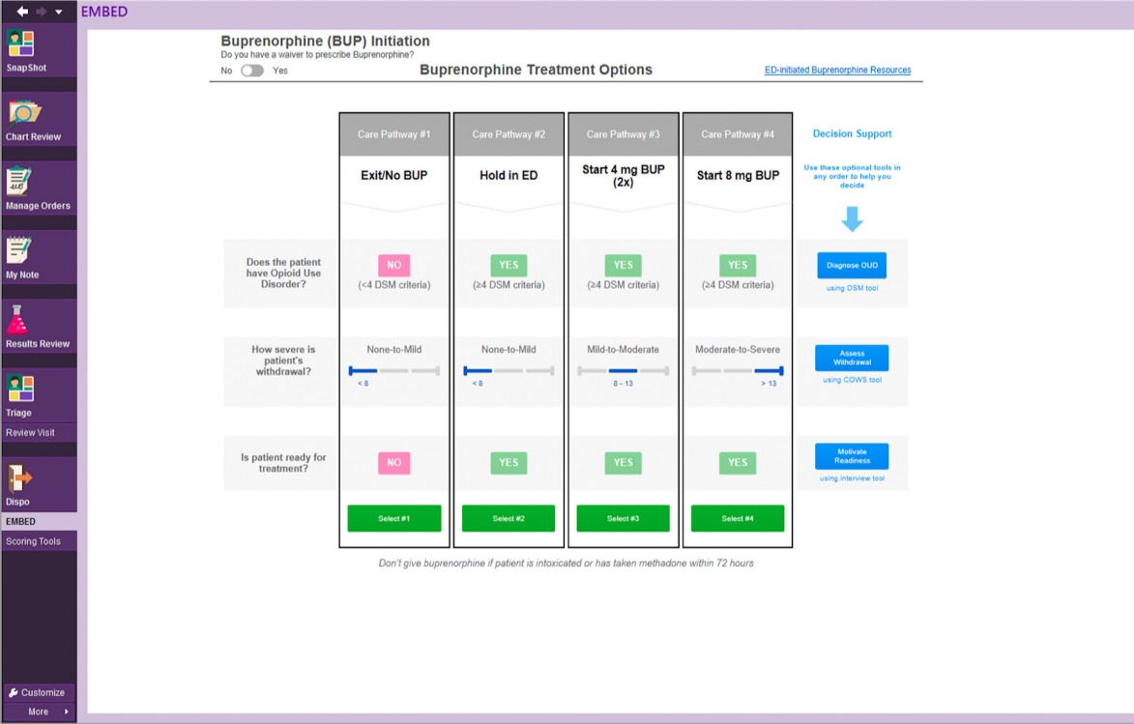
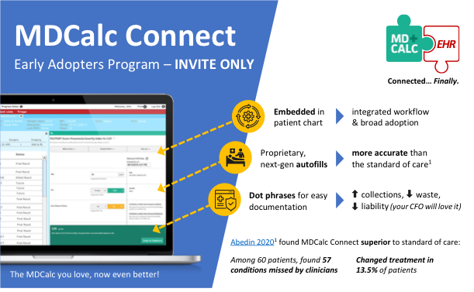
Clinical Decision Support
Search: ED Buprenorphine
Desktop/phone app coming soon!
Melnick, BMJ Open, 2019

Slide 48
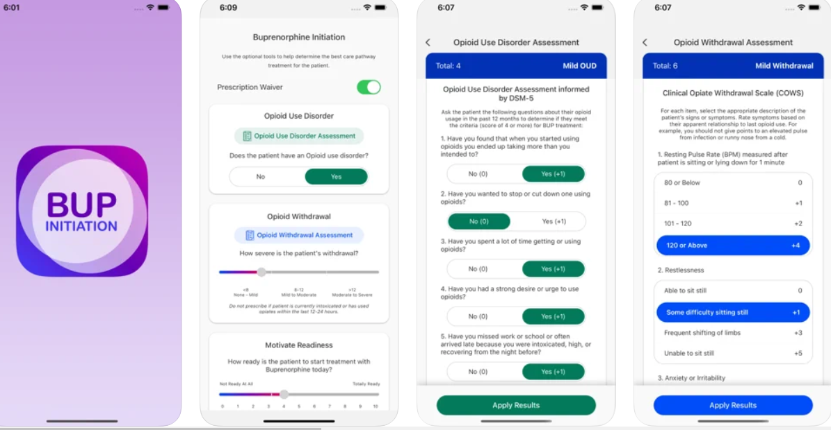
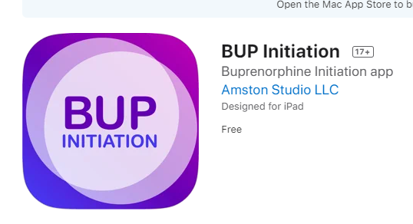
BUP Initiation App (available in apple store and google)
Funded by NIDA
APPLE: https://apps.apple.com/us/app/bup-initiation/id1574350314
GOOGLE: https://play.google.com/store/apps/details?id=com.amstonstudio.yaleembed

Slide 49
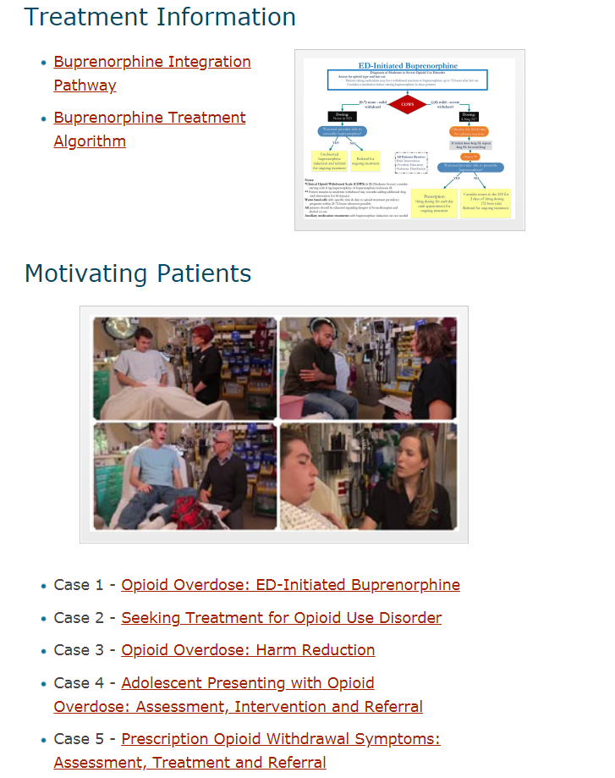
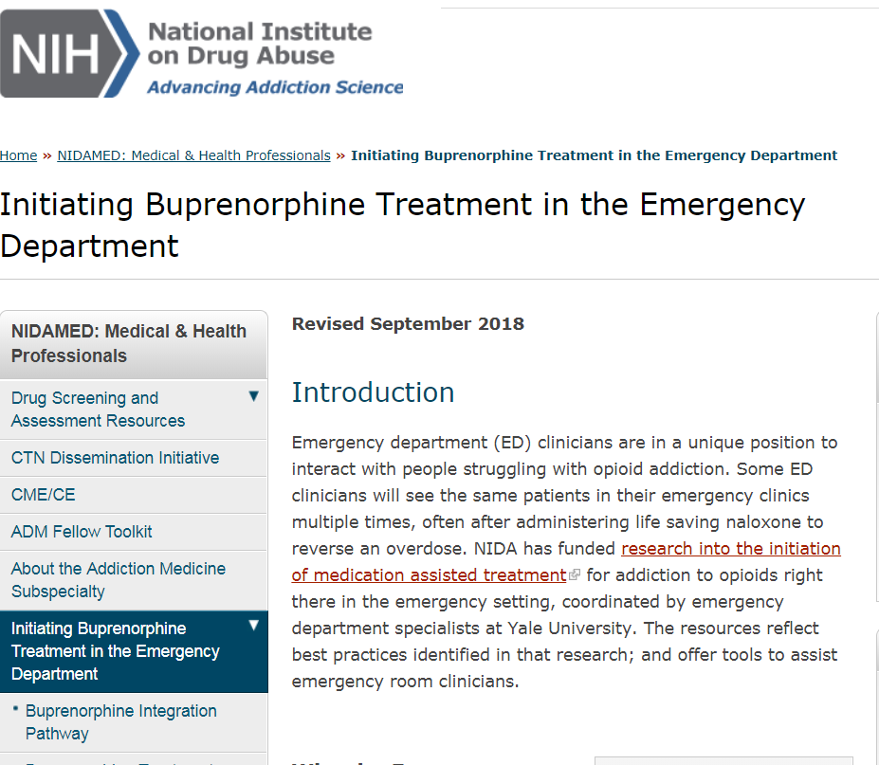
NIDA Website https://www.drugabuse.gov/ed-buprenorphine

Slide 50
Testing Innovative Treatments

Slide 51
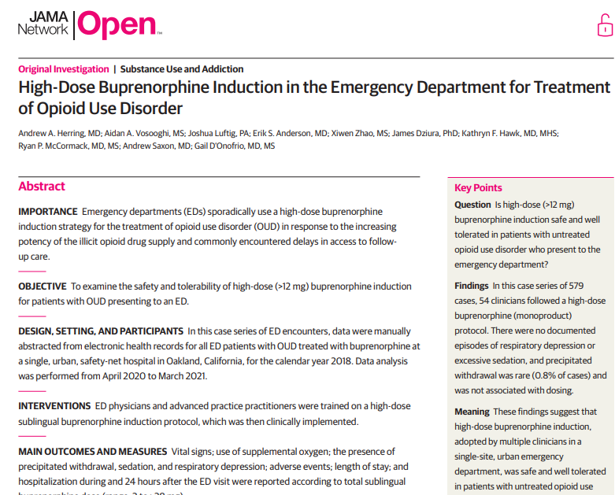

High-Dose Buprenorphine (>12mg) Induction for Treatment
of Opioid Use Disorder
CTN 0069-A1
Accelerated induction achieves therapeutic buprenorphine levels in < 3-4 hours vs typically 2-3 days… extended-release increases safety during the crucial gap between ED & follow-up care… particularly in context of COVID limitations
Retrospective case series –
2018 calendar year at a single site – Highland Hospital, Oakland CA.
391 unique patients (579 encounters)
No cases of respiratory depression or sedation
5 cases of precipitated withdrawal not dose related
High dose buprenorphine induction was safe and well tolerated in untreated OUD patients
Herring, JAMA Netw Open. 2021 July

Slide 52
Outcomes
Total Buprenorphine Dose (mg sublingual)
 | 2-6 n=55 | 8 n=136 | 10-12 n=22 | 16 n=106 | 20-24 n=122 | 28+ n=138 | p-value^{b}
Length of Stay—hoursª | 3.5 (2.4-5.8) | 2.6 (1.7-4.4)^{d} | 2.6 (2.1-3.7) | 2.1 (1.5-3.5)^{d,e} | 2.2 (1.4-3.3)^{d} | 2.3 (1.7-3.6)^{d} | 0.002
Precipitated Withdrawal—no. (%) | 0 | 4 (2.9%) | 0 | 0 | 0 | 1 (0.7%) | 0.20
Hospitalization—no. (%) | 5 (9.1%) | 4 (2.9%) | 1 (4.5%) | 3 (2.8%) | 8 (6.6%) | 4 (2.9%) | 0.26
Return to ED within 24 Hours—no. (%) | 2 (3.6%) | 10 (7.4%) | 3 (14%) | 9 (8.5%) | 6 (4.9%) | 15 (11%) | 0.32
Time to Return to ED Within 24 Hours—hoursª | 13.8 (12-16) | 11.4 (5.9-14) | 17.8 (11-20) | 10.4 (6.5-23) | 15.1 (13-18) | 18.4 (14-22) | 0.52
ª Median and interquartile range ^{b} p-value for any differences among categories of total buprenorphine sublingual dose
^{c} p-value for any difference in the proportions of encounters that were by advance practice providers across the total buprenorphine dose categories.
After significant omnibus test, all pairwise comparisons were performed. Results of pairwise dose category comparisons that are significant are marked
by a superscript indicating which column was different: ^{d} p<0.05 for pairwise comparison to 2-6 mg total dose
^{e} p<0.05 for pairwise comparison to 8 mg total dose

Slide 53
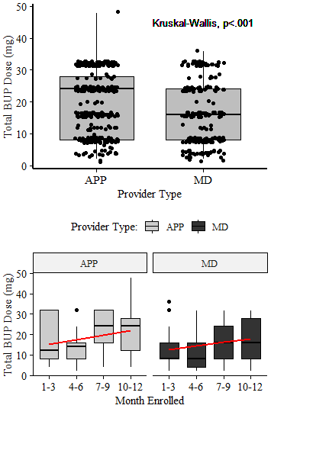
Buprenorphine Dose Administered by MDs & APPs
Each dot represents a unique patient encounter
54 unique providers were observed. All 21 APPs (100%) and 29 MDs (29/33=88%) have administered high-dose buprenorphine at least once.
High-Dose Induction Safe and Effective

Slide 54

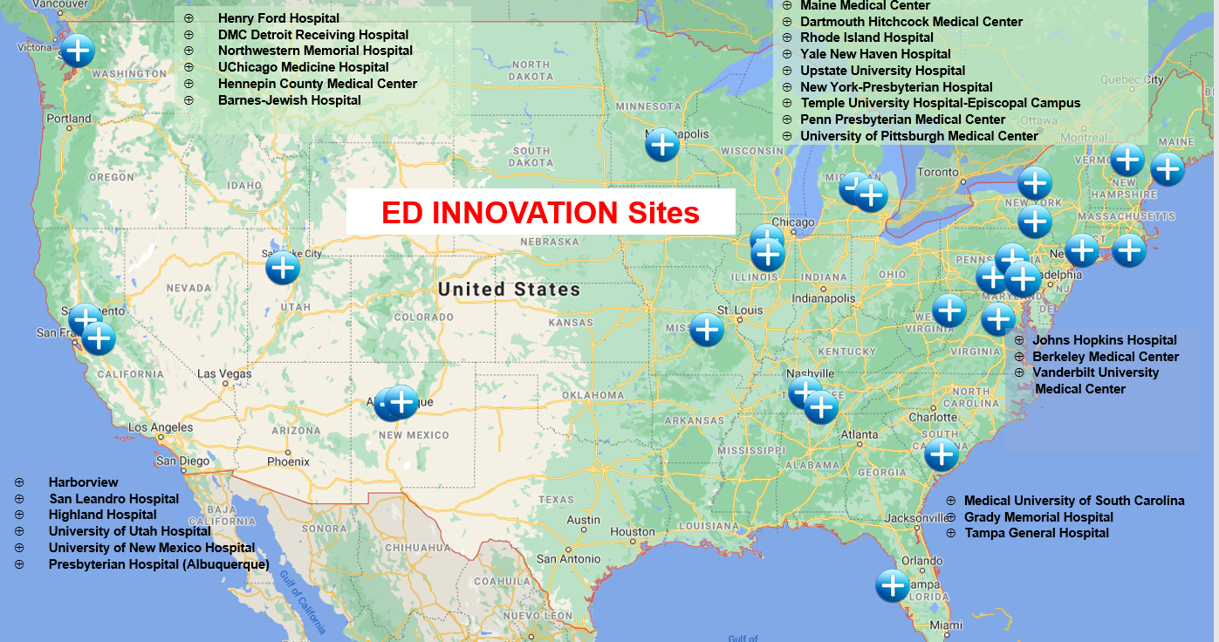
Buprenorphine Formulations
ED INNOVATION
ED-INitiated BupreNOrphine VAlidaTION Network Trial
To compare the effectiveness of XR-BUP and SL-BUP induction (8-12mg) in approximately 2000 patients with untreated OUD in the ED on the primary outcome of engagement in formal addiction treatment at 7 days
RCT
750+ enrolled 27 Sites
Lead Investigators
Ancillary
85 enrolled
D'Onofrio, Contemporary Clinical Trials, 2021
Notes:
Explain that in a Hybrid Type 1 design, Effectiveness is the most important component - Type 1 hybrid designs rigorously test the clinical intervention and secondarily gather data to inform subsequent implementation research trials - I added a red box!

Slide 55
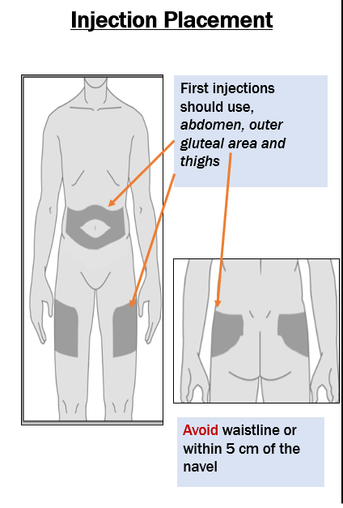
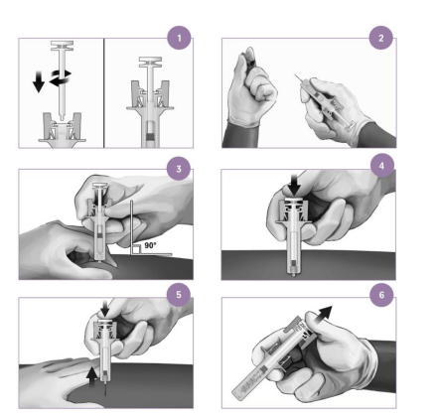
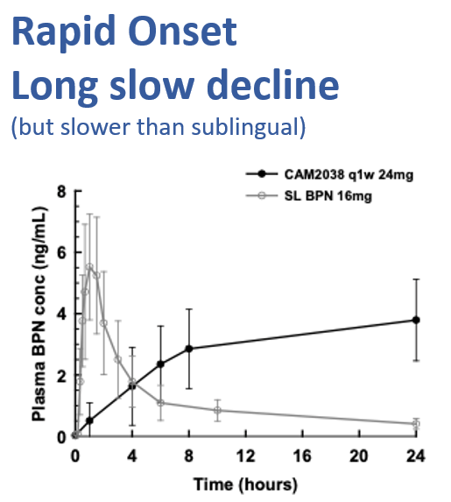
ED INNOVATION
CAM2038 24mg XR-BUP 7-day injectable vs 16mg SL-BUP per day
Pharmacokinetics of
XR- & SL- Buprenorphine
3UG1DA015831

Slide 56
CTN 0099 Substance Use (POC Urine Testing)
Substance | Overall (N = 361) | Region
 |  | East – 18 sites (N = 213) | West – 8 sites (N = 148) | P Value
N (%)
Opioid + Other Drug | 301 (83.4) | 171 (80.3) | 130 (87.8) | 0.06
Opioid + Marijuana | 170 (47.1) | 95 (44.6) | 75 (50.7) | 0.26
Opioid + Benzodiazepines | 64 (17.7) | 48 (22.5) | 16 (10.8) | 0.004
Fentanyl Only | 17 (4.7) | 15 (7.0) | 2 (1.4) | 0.01
Fentanyl + Other Drug | 244 (67.6) | 168 (78.9) | 76 (51.4) | <.0001
Fentanyl + Any Other Opioid | 186 (51.5) | 129 (60.6) | 57 (38.5) | <.0001
Opioids & Stimulants
Opioid + Meth | 119 (33.0) | 39 (18.3) | 80 (54.1) | <.0001
Opioid + ATS | 131 (36.3) | 47 (22.1) | 84 (56.8) | <.0001
Opioid + Any Stimulant | 208 (57.6) | 110 (51.6) | 98 (66.2) | 0.006
Opioids = buprenorphine, opiates, oxycodone, fentanyl
Other Drugs = amphetamines, barbiturates, benzodiazepines, cocaine, ecstasy, methamphetamine, phencyclidine, marijuana
ATS = methamphetamine, Amphetamine
Stimulant = Cocaine, amphetamine, methamphetamine, phencyclidine
Active Surveillance

Slide 57
We Know…
The Extent of the Problem
Treatment Works
The ED Offers 24/7/365 Day Option to combat the Opioid Crisis
The Consequences of Inaction
The Evidence
We Learned…
How to Break Down Barriers & Increase the Chances Of Success
We Are Investigating…
Implementation strategies, dosing & formulations, surveillance techniques

Slide 58

At the End of the Day……
https://www.statnews.com/2021/08/13/emergency-departments-cannot-ignore-addiction-care-medically-legally-morally/

Slide 59
Offering ED-initiated buprenorphine is NOT a choice!!

Slide 60

https://cabridge.org/

Slide 61

Thank you!!!
Websites: https://www.drugabuse.gov/ed-buprenorphine https://medicine.yale.edu/edbup/

Slide 62


Slide 63

https://cabridge.org/resource/buprenorphine-bup-hospital-quick-start/

