Slide 1
UVM Health Network
Faculty Session
with Drs. Everett, Garrison and Zehle
Essential of Teaching and Assessment Program
September 30, 2021

Slide 2
LCOM Missions
Clinical
Research
Community
Education
Notes:
These are standing committees of the faculty.
The first four (bolded) are the committees related to our medical education program.
CQI – most recently established committee. We would work closely with this committee.
Last two are more faculty focused.

Slide 3
The Larner College of Medicine at the University of Vermont Vision Statement: Medical Education
Education
We will be a college of medicine respected by our peers for our innovative and outstanding teaching. We will be distinguished by preparing graduates who achieve excellence in their chosen fields and who demonstrate extraordinary compassion and commitment to the service of patients, the medical profession and the community.

Slide 4
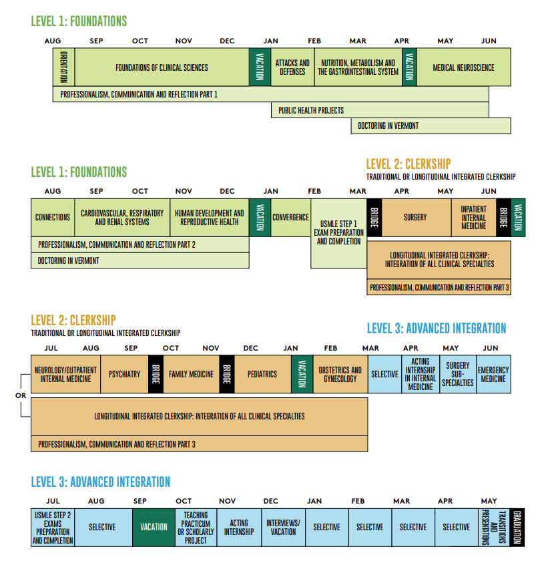
http://med.uvm.edu/docs/vic/medical-education-documents/vic.pdf

Slide 5
Committee Relationships
Level Subcommittee
Evaluation Subcommittee
Continuous Quality Improvement
MEDICAL CURRICULUM COMMITTEE
Medical Curriculum Committee
Notes:
Feedback needed and requested for this proposal of the relationship between these committees/subcommittees seen here with this new structure.
Level Subcommittees would do an annual review of things related to their level courses and their courses in their levels, using the QAR as their tool.
Level director would have summary of strengths, concerns and changes to be implemented to present to MCC instead of going over the entire report.
Evaluation Subcommittee conducts an independent, comprehensive review of required courses every two years, utilizing other tools (evaluations, GQ, etc.) and they would provide a summary report to MCC.
CQI: Looks more specifically at elements however may identify curriculum concerns or areas to be addressed and would bring those to MCC for awareness and consideration for any changes needed.

Slide 6
Medical Education Outcomes
Admissions Data
Match Data
Satisfaction Data
Perceptions of Competency

Slide 7
Class of 2024
Class of 2025
Median GPA | 3.62
Median BCPM GPA | 3.56
New MCAT | 510
In-State Students | 30
Out of State Students | 94
% Medically Related Experience | 100
% Underrepresented in Medicine | 19
Median GPA | 3.70
Median BCPM GPA | 3.64
New MCAT | 512
In-State Students | 30
Out of State Students | 94
% Medically Related Experience | 100
% Underrepresented in Medicine | 22

Slide 8
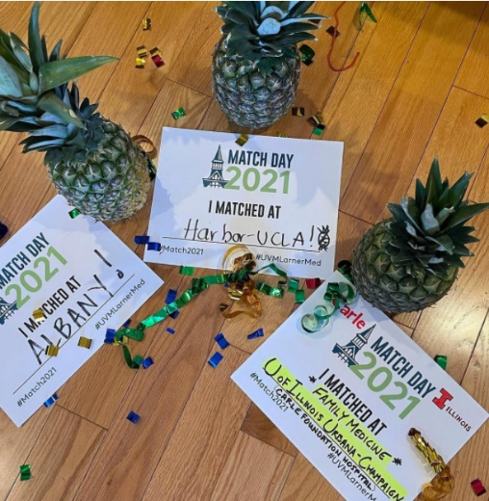
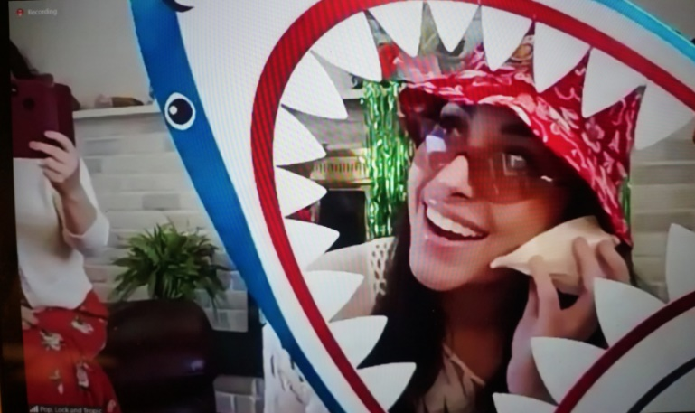
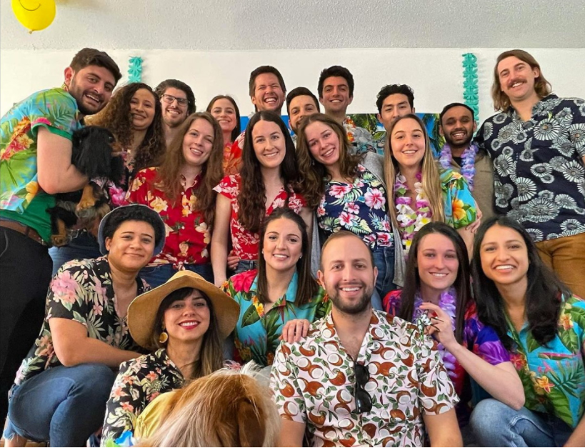
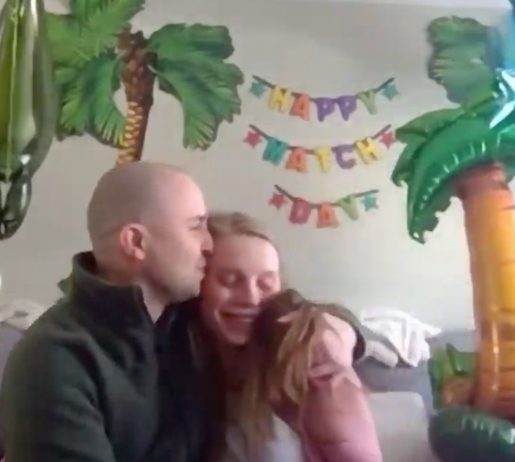
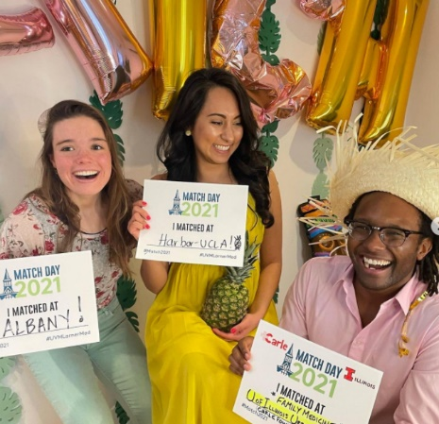
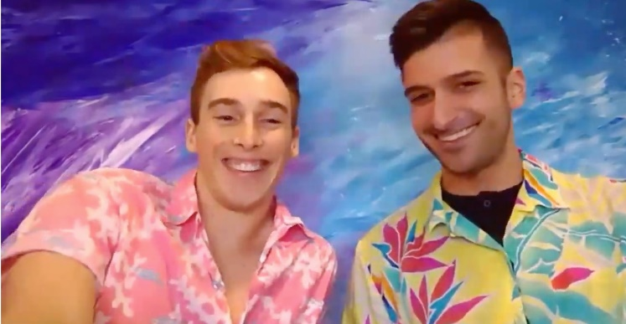
2021 Main Residency Match

Slide 9
Class of 2020 Residency Specialties
Specialty | # LCOM Students | % US MD Seniors | % Total
Internal Medicine | 16 | 39 | 95.7
Pediatrics | 15 | 60.3 | 98.6
Emergency Medicine | 14 | 62.1 | 99.5
Anesthesiology | 11 | 70.1 | 99.8
Family Medicine | 10 | 33.3 | 92.7
General Surgery | 9 | 65.6 | 99.7
Psychiatry | 8 | 63.2 | 99.8
Preliminary Medicine | 6 | 66.0 | 89.4
Preliminary Surgery | 6 | 23.9 | 53.9
Pathology | 3 | 32.4 | 96.4
Dermatology | 2 | 83.3 | 100.0
Diagnostic Radiology | 2 | 58.2 | 96.7
Obstetrics & Gynecology | 2 | 74.5 | 99.8
Plastic Surgery | 2 | 89.3 | 100.0
Child Neurology, Neurological Surgery, Neurology, Ophthalmology, Orthopaedic Surgery, Otolaryngology, PM&R, Transitional Year | 1
Notes:
Depends on competitiveness of specialty and number of programs
Thoracic Surgery 93.5 (MD seniors)
Path/surgery prelim lowest

Slide 10
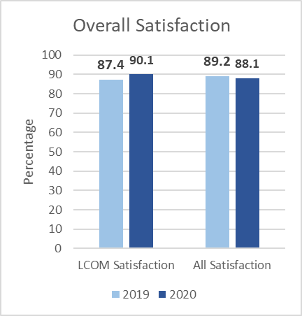
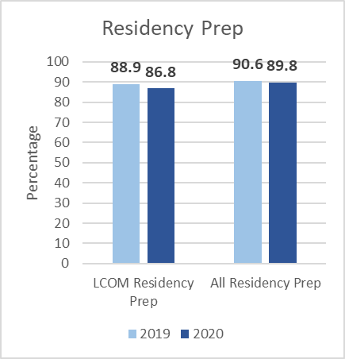
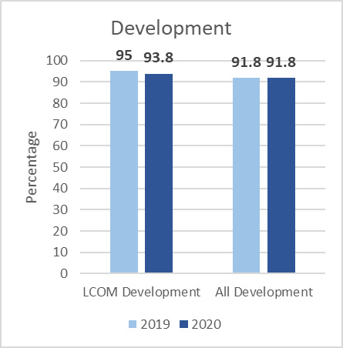
GQ National Trends
Majority of Students are Satisfied
Notes:
I put these 2 slides about trends at the beginning, so that you could put them wherever you want!
These questions for this slide were:
Overall, I am satisfied with the quality of my medical education – LCOM went up and his higher than national, while nationally, it went down slightly
I am confident that I have acquired the clinical skills required to begin a residency program. – LCOM went down and is lower than national, while nationally went down slightly
My medical school has done a good job of fostering and nurturing my development as a future physician – LCOM went down, but is higher than national; national stayed stable (Development as Physicians)
Are you glad you became a doctor -

Slide 11
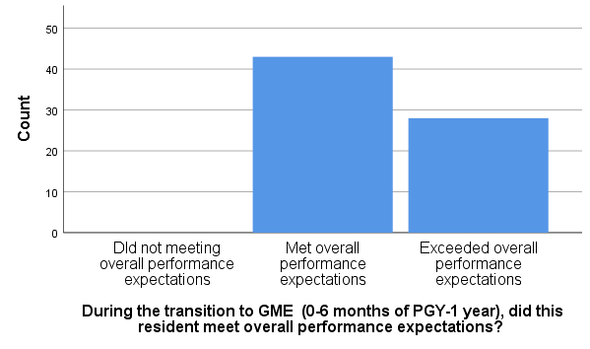
2020 Program Directors’ Survey: Overall Performance
 | LCOM (n=71) | National (n=5527)
Did not meet overall performance expectations | 0% (0) | 2.5%
Met overall performance expectations | 58.9% (43) | 63.3%
Exceeded overall performance expectations | 38.4% (28) | 34.2%

Slide 12
Medical Education Opportunities
Commitment to the Learning Environment
Teaching Academy
Medical Education Program

Slide 13
Commitment to ensuring a positive learning environment
Faculty model professional behavior (Highlights)
Honesty and integrity
Syllabus = contract
Students expected to attend, participate, complete assignments, etc.
Foster mutual respect (civil communication, no discrimination or favoritism, abuse, humiliation, harassment)
Competence in your discipline
Competence as a teacher
Evaluate student performance and comply with FERPA
Be familiar with and follow UVM policy on Equal Opportunity in Educational Programs
No romantic relationships or overtures
Ethical behavior
Compliance with all policies and laws

Slide 14
Community of scholarly educators
Support teachers through faculty development, peer evaluation educational modules and publications
Evaluate the curriculum and teaching
Perform Medical Education Research
Foster innovation
Recognize excellent teachers
Support promotion and tenure

Slide 15
Clinical Teaching at Essentials of Teaching and Assessment It’s not too late to join us virtually!
Friday, October 1
8:00 - 9:00 AM | Plenary Creating a Positive Learning Environment Judith Lewis, MD; Nathalie Feldman, MD | Zoom Link Meeting ID: 943 3224 4841
9:15 – 10:30 AM | Breakout Sessions
A | Feedback Essentials Richard Bounds, MD; Sarah Schlein, MD | Zoom Link Meeting ID: 940 4908 7432
B | Patient Centered Teaching Karin Gray, MD; Lewis First, MD | Zoom Link Meeting ID: 937 9313 7902
10:45 - 12:00 PM | Breakout Sessions
A | Small Group Facilitating Stephen Berns, MD; Martha Seagrave, RN, PA | Zoom Link Meeting ID: 926 8680 6905
B | Writing Inclusive Cases Karen Lounsbury, PhD | Zoom Link Meeting ID: 990 8837 1299
See your Program for details!

Slide 16
Virtual Fall Faculty Development Events Join us from anywhere-events hosted via Zoom!
Medical Education Grand Rounds
October 22: Tracking Progress in a Competency-Based Medical Curriculum with Robert Malinowski, PHD, DVM, MA, Office of Medical Education Research and Development, College Of Human Medicine, Michigan State University; Heather Laird-Fick, MD, MPH; and Gary Ferenchick, MD, College of Human Medicine, Michigan State University
November 12: Entrustable Professional Activities: The Next Step in Meaningful Assessment of Clinical Competence with Robert Englander, MD, MPH, University of Minnesota Medical School
December 10: Deconstructing Racism and Bias in Medical Education: Guiding Principles for Inclusive Curriculum Design with Priya Garg, MD, Boston University School of Medicine
*All sessions Noon to 1pm.
Faculty Development Series for Clinical Teachers 201
September 23: Teaching Clinical Reasoning with Emily Greenberger, MD
October 28: Teaching Procedural Skills/Teaching in the OR with Elise Everett, MD
*All sessions 7:30-8:30am. More sessions to be announced.
RSVP for one or all sessions: Teaching.Academy@med.uvm.edu

Slide 17
Get Involved!
Teaching in the Foundations (basic sciences) curriculum.
Small group facilitators
Content experts (active learning, TBLs, didactic)
Teaching in the Clinical Curriculum
Attending on service (become familiar with the student assessment tools, learning environment expectations, how to provide feedback)
Career Advising
Advising or mentoring students in your specialty (become familiar with the residency application process, match outcome data, student academic profiles)
Join the Teaching Academy: www.med.uvm.edu/teachingacadem/home

Slide 18
General Medical Education Questions: Christa Zehle, M.D.
Foundations teaching:
Karen Lounsbury, Ph.D. | karen.lounsbury@med.uvm.edu
Clerkships:
Elise Everett, M.D.| elise.everett@uvmhealth.org
Advanced Integration Electives:
Garth Garrison, M.D.| garth.garrison@uvmhealth.org
Career Advising:
Lee Rosen, Ph.D.| lee.rosen@med.uvm.edu
Simulation and Standardized Patients:
Cate Nicholas | cate.nicholas@uvm.edu
Committees:
Colleen Case | colleen.case@med.uvm.edu
Faculty Development for Teaching:
Teaching Academy | Kathryn.Huggett@med.uvm.edu
Get Involved!

